Slide 1
Form 6252 Gone Wrong
Trials and Tribulations of Preparing Form 6252
John Niemi, EA, MAcct

Slide 2
Revenue Act of 1926
CHAP. 27.
—An Act To reduce and equalize taxation, to provide revenue, and for other purposes.
  Wherewithal-to-Pay Concept
  Realized vs Recognized Gain
§212(d)
A person who regularly sells or otherwise disposes of personal property on the installment plan.
Casual sale of personal property or sale of Real Property
  Less than ¼ of selling price in first year
Notes:
§212(d) Under regulations prescribed by the Commissioner with the approval of the Secretary, a person who regularly sells or otherwise disposes of personal property on the installment plan may return as income therefrom in any taxable year that proportion of the installment payments actually received in that year which the total profit realized or to be realized when the payment is completed, bears to the total contract price.
(2) of a sale or other disposition of real property, if in either case the initial payments do not exceed one-fourth of the purchase price

Slide 3
Internal Revenue Code of 1939
Installment Sales moved to §44 Installment Basis
  Raised limit to 30% payment in first year
  Gain or Loss on sale of Installment Obligation
    Sale at less than Face Value or other Distribution
    Gain or Loss to be Recognized to Original Seller
  First reaction of Congress to Abuses
  To get around Sale at Less than Face Value, a 3rd party is involved
    S owns stock in closely held company with basis of $50K
    S gets offer from B to purchase for $5M but is told to reject
    S creates a Trust and sells to Trust for $5M ( 20 year note bearing 6%)
      Defers recognition
    Trust sells Stock to B for $5M at no gain
      Trust invests proceeds for the benefit of S’s Children Example from Herbert Lerner’s
            Installment Sales Revision Act of 1980
Notes:
§44(d)Any gain or loss so resulting shall be considered as resulting from the sale or exchange of the property in respect of which the installment obligation was received. No mention of related party in §44

Slide 4
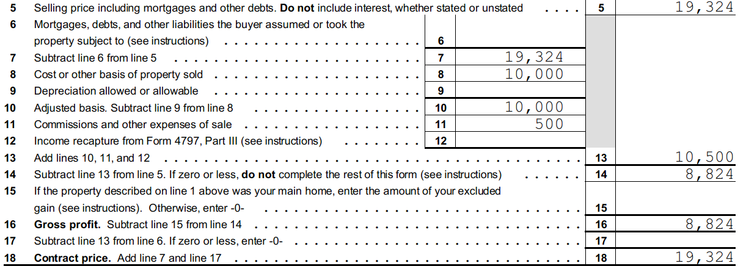

30% 1st Year Limit ➔ to Wrapped Mortgages
No Mortgage Assumption
Mortgage Assumption
Assume 1st Payment is $4,000 per contract
First Year Payment Limited to $5,797
Meets Installment Sale Criteria
1st year $1,826 in Capital Gains
First Year Payment Limited to $3,397
Fails Installment Sale Criteria
1st…and only year $8,824 Capital Gains
Notes:
In the case of a wrapped mortgage, the original (senior) debt is retained and the seller pays the mortgage. The first year amount allowed is greater because the selling price is not reduced by the assumption.
Learner (p 13) characterized the limit as a trap because in the case of inadequate interest (remember when interest was 9-18%?), the re-characterization of the contract price would lower the allowed first year payment and potentially fail the 30% limit and thus defeat the installment sale entirely. The entire gain might be due the first year.
Another failure might be when the mortgage exceeded the basis of the property. In that case, the excess was considered a payment in the year of sale also.
Important not to have the buyer assume the mortgage or take possession “subject to” the mortgage in wrap around mortgages.
See Professional Equities, Inc. v Commissioner, 89 TC 165
Stonecrest v. Commissioner 24 TC 659

Slide 5
Internal Revenue Code of 1954
§453 Installment Method
Still no related Party Transactions
  Change from Accrual Method to Installment Method
  Tax adjustments allowed for Installment sales prior to 1954
  Corporate Liquidation
  Retained the First Year Payment requirement of <30% of Selling Price

Slide 6
Public Law 96-471, Installment Sales Revision Act of 1980
Public Law 96-471, Installment Sales Revision Act of 1980
  Eliminated 30% limit on 1st year.
  Focused on Related Party Transactions
  Rules for Sales of Real Property and non-dealer sales of personal property
  3rd party guarantees not treated as payment.
  Added §453A
    Rules for Sales by dealers in personal property
  Added §453B
    Rules for dispositions of installment obligations
Notes:
Bipartisan 2 year effort to clean up the many issues of installment sales: Rules for non-dealer sales of personal property, real property sales, what happens in sales to related parties.
Added 2 sections; sales by dealers in personal property and dispositions of the installment obligations.
Of course §453 has continued to be amended. 1986 improved rules for corporate liquidations and stock dispositions.
1987 revised rules for the newly added sections. Amendments continued in 1988, 1999, 2000, and 2004
This effectively killed the example shown previously.
Subsequent revisions dealt more with corporations, liquidations, and other technical issues and are not dealt with here.

Slide 7
PL 97-34, 1981
New subsection (i) dealing with recapture
  Property placed in service after 12/31/1980
Gain in excess of recapture = gain under installment method
Recapture income
  Amount treated as ordinary income under §1245 or §1250
Notes:
i) Recognition of recapture income in year of disposition (1) In general In the case of any installment sale of property to which subsection (a) applies— (A) notwithstanding subsection (a), any recapture income shall be recognized in the year of the disposition, and
(B) any gain in excess of the recapture income shall be taken into account under the installment method.
(2) Recapture income For purposes of paragraph (1), the term “recapture income” means, with respect to any installment sale, the aggregate amount which would be treated as ordinary income under §1245 or §1250 (or so much of section 751 as relates to section 1245 or 1250) for the taxable year of the disposition if all payments to be received were received in the taxable year of disposition.

Slide 8
Treas Reg 15a.453-1(b)(3)(ii) Invalid
Stonecrest v Commissioner 1955
Professional Equities v Commissioner 1987
Corp sold properties on IS based on Revenue Act of 1939
Wrap Around Mortgage
Seller paid and after X years B assumed mortgage
IRS relied on TR 29-44.2 and reduced contract price by assumed Mortgage
Opinion for Stonecrest
Installment Sales Revision Act of 1980
  Did not change language
  IRS promulgated “highly complicated and confusing” Temp Regs 1981
The TC invalidated the Temp Reg
Wrap Arounds properly constructed do not reduce contract price by wrapped mortgage
Notes:
TC ruled in Stonecrest that:
“By his interpretation respondent would extend the application of the regulation to every sale of property that has a mortgage on it. While in a sense every sale of mortgaged property is subject to a mortgage sine the property remains liable to have the mortgage debt satisfied from it, we think the expression was used in the regulation in its customary meaning, to define the obligations of the parties to a sale of property with mortgage debt. …..
It was held that the rule prescribed in the regulations for the determination of the percentage of profit returnable each year in the case of mortgaged property sold on the installment plan was inapplicable.
TC ruled in Professional Equities
“The method by which this goal is accomplished is virtually incomprehensible from the words of the regulation, set forth in the margin”
“The Government’s attempt to support the temporary regulation under attack is made even more egregious by its use of the Installment Sales Revision Act of 1980 to justify the changes made by the temporary regulations.”
“The tortuously complex temporary regulations promulgated under the pretext of interpreting the changes made in the 1980 Act can in no way be considered compatible with the goals of that Act.
15a.453-1(b)(3)(ii)
(ii) Wrap-around mortgage. This paragraph (b)(3)(ii) shall apply generally to any installment sale after March 4, 1981 unless the installment sale was completed before June 1, 1981 pursuant to a written obligation binding on the seller that was executed on or before March 4, 1981. A “wrap-around mortgage” means an agreement in which the buyer initially does not assume and purportedly does not take subject to part or all of the mortgage or other indebtedness encumbering the property (“wrapped indebtedness”) and, instead, the buyer issues to the seller an installment obligation the principal amount of which reflects such wrapped indebtedness. Ordinarily, the seller will use payments received on the installment obligation to service the wrapped indebtedness. The wrapped indebtedness shall be deemed to have been taken subject to even though title to the property has not passed in the year of sale and even though the seller remains liable for payments on the wrapped indebtedness. In the hands of the seller, the wrap-around installment obligation shall have a basis equal to the seller's basis in the property which was the subject of the installment sale, increased by the amount of gain recognized in the year of sale, and decreased by the amount of cash and the fair market value of other nonqualifying property received in the year of sale. For purposes of this paragraph (b)(3)(ii), the amount of any indebtedness assumed or taken subject to by the buyer (other than wrapped indebtedness) is to be treated as cash received by the seller in the year of sale. Therefore, except as otherwise required by section 483 or 1232, the gross profit ratio with respect to the wrap-around installment obligation is a fraction, the numerator of which is the face value of the obligation less the taxpayer's basis in the obligation and the denominator of which is the face value of the obligation.

Slide 9
§453 Installment Method
The term “installment sale” means a disposition of property where at least 1 payment is to be received after the close of the taxable year in which the disposition occurs.
Mandatory, except as otherwise provided in §453
  Exclusions
    Inventory
    Dealer Dispositions
  Opt Out on or before due date of the tax return on which disposition is reported
    Revocation only with approval of Secretary
Notes:
Opt out by filing a tax return. Code says “Such an election shall be made in the manner prescribed by regulations.”§453(d)(2). There is a temporary regulation from the 1980 Installment Sales Revision Act. § 15a.453-1(d)(3)
The election must be made in the manner prescribed by the appropriate forms for the taxpayer's return for the taxable year of the sale.
Dealer Dispositions §483(l) defines Dealer Dispositions as (A) disposition of personal property by a person who regularly sells personal property of the same type on an installment plan. (B) a disposition of real property by a taxpayer in the ordinary course of the taxpayer’s trade or business (except Farms and Timeshares) which are beyond this discussion.

Slide 10
§453 Requirements
Contract
Losses are excluded from Installment Sales
§453(e), Related Persons
  2 year window for disposals by related parties
    Diminished risk of loss by related party
    Except marketable securities
§453(f)(4) evidences of indebtedness
  Payable on demand
  Readily Traded Security
Notes:
Related Person
1. A person whose stock would be attributed under §318(a) [Constructive ownership of stock]; spouse, children, grandchildren, and Parents
(b) Relationships The persons referred to in subsection (a) are: (1) Members of a family, as defined in subsection (c)(4);
(2) An individual and a corporation more than 50 percent in value of the outstanding stock of which is owned, directly or indirectly, by or for such individual;
(3) Two corporations which are members of the same controlled group (as defined in subsection (f));
(4) A grantor and a fiduciary of any trust;
(5) A fiduciary of a trust and a fiduciary of another trust, if the same person is a grantor of both trusts;
(6) A fiduciary of a trust and a beneficiary of such trust;
(7) A fiduciary of a trust and a beneficiary of another trust, if the same person is a grantor of both trusts;
(8) A fiduciary of a trust and a corporation more than 50 percent in value of the outstanding stock of which is owned, directly or indirectly, by or for the trust or by or for a person who is a grantor of the trust;
(9) A person and an organization to which section 501 (relating to certain educational and charitable organizations which are exempt from tax) applies and which is controlled directly or indirectly by such person or (if such person is an individual) by members of the family of such individual;
Does not include “evidence of indebtedness” even if guaranteed by 3rd party.

Slide 11
§453 Requirements continued
§453(g) Sale of Depreciable Property to Controlled entity
  All payments to be received treated as received in year of sale
  No basis increase for B until S includes payments in Gross Income
Shareholder of Closely Held C corp sells Office Building
  Needs cash
    does not want to take stock in a §351 tax free exchange

Slide 12
Land purchased for investment
A, an individual, purchased land for Investment in 2010 for $10,000
Sold to B on installment sale 1/1/15 for $20,000
  5 payments of $4,000.
    First Payment is 1/1/15
      Considered an interest free down payment
    4 Payments due Jan 1 of 2016-2019
  A incurred $500 selling costs
Notes:
Most examples of Installment Sales start with selling Land purchased for investment. Why? No depreciation, therefore no depreciation recapture to consider or explain.
Without asking additional questions, you really don’t know if there was stated interest, a related party involved, did a mortgage exist and was assumed by Buyer?
Need to generate a list of questions based on the Form 6252.

Slide 13
Gross Profit % Calculation
  Gross Profit
Gross Profit % =
Contract Price
Sales Contract | $ 20,000
Adjusted Basis | $ 10,000
Selling Expense | $ 500
Gross Profit | $ 9,500
Gross Profit % = 9,500/ 20,000 = .4750

Slide 14
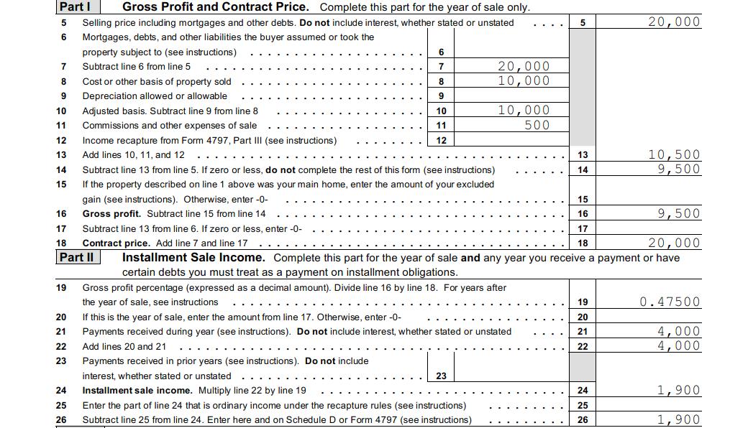
Notes:
This is the Form 6252 for the down payment of $4,000. Since there is not interest assumed with a down payment, only the return of capital ($2,100) and the Installment Sale Income ($1,900 ) is reported.

Slide 15
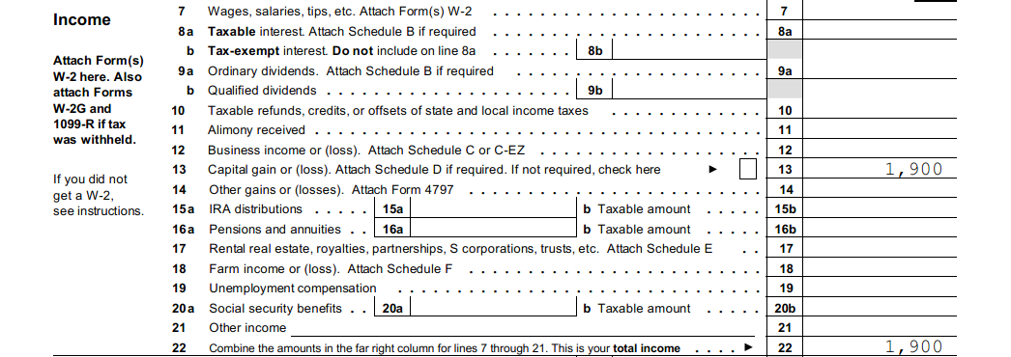
There is no interest because a down payment generally is interest free.
The capital gain was calculated on 6252 as $4000 x 47.5%
Notes:
$2100 is a tax free return of capital. There is no interest because the payment was a down payment.

Slide 16
Adequate Interest?
Contract has adequate interest if the stated interest is greater than the Test Rate §483(b)➔§1274(b)(2)
  Test Rate is the 3 month rate the lower of the 3 month period
    Binding contract
    Sales Executed.
  Rate used depends on length of contract and compounding periods
    <= 3 year AFR Short Term
    >3 <= 9 year AFR Mid Term
    > 9 year AFR Long Term
  Table 1 of the Revenue Ruling is used
Notes:
Now, you should ask the taxpayer:
I don’t see any interest in your contract. What was the interest? His reply” Bob is a friend, we just said that he could pay $4K in 5 payments.
You say…..I think the IRS says you have to charge interest and if not….then you have to recharacterize the payment as part principal, part interest, and part return of capital.

Slide 17
AFR Examples
 | Year | Table 1: AFR
 |  | Annual | Semiannual | Quarterly | Monthly
 | Jan, 2015
Short-Term |  | 0.41 | 0.41 | 0.41 | 0.41
Mid-Term |  | 1.75 | 1.74 | 1.74 | 1.73
Long-Term |  | 2.67 | 2.65 | 2.64 | 2.64
 | Jan, 2000
Short-Term |  | 5.88 | 5.8 | 5.76 | 5.73
Mid-Term |  | 6.21 | 6.12 | 6.07 | 6.04
Long-Term |  | 6.45 | 6.35 | 6.3 | 6.27
 | Jun, 1990
Short-Term |  | 8.4 | 8.23 | 8.15 | 8.09
Mid-Term |  | 8.66 | 8.48 | 8.39 | 8.33
Long-Term |  | 8.67 | 8.49 | 8.4 | 8.34
https://apps.irs.gov/app/picklist/list/federalRates.html
Notes:
Not going to show all three months. We assume that the interest rates for Jan, 2015 are the lowest of the 3 month period for simplicity.
You can get the rates here:
https://apps.irs.gov/app/picklist/list/federalRates.html

Slide 18
Notes:
If there is no stated interest or the interest is less than the TEST RATE described above, then you have to decide which IRC section to use to determine the interest required to be reported.
This flow chart is based on Pub 537, page 11.
§ 1274 is the default. However, there are so many exceptions that most transactions will fall under §483 as shown in the flow chart.

Slide 19
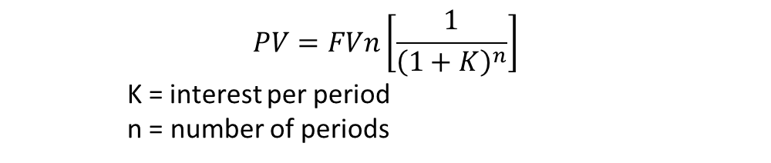
§483 Rules Generally Apply
Total Unstated Interest
Excess of Sum of Payments over PV of Interest and PV of Payments
$$PV=FVn\left[\frac{1}{{\left(1+K\right)}^{n}}\right]$$
K = interest per period
n = number of periods
Notes:
Use appropriate compounding rate from the AFR. See cautionary slide later in the presentation.

Slide 20
Cash Flow Timeline For Land
Build a Cash Flow Timeline: Down Payment + 4 Installment Payments
Financial Calculator
N=4
I=1.75%
PMT=-4000
FV=0
PV = 15,323.77
DP= 4,000
Sum 19,323.77
Down 4000
PV =4000/[1.0175)¹
PV = 4000/[1.0175)²
PV = 4000/[1.0175)³
DP $ 4,000
PV1 $ 3,931.20
PV2 $ 3,863.59
PV3 $ 3,797.14
PV4 $ 3,731.83
Total $19,323.73
Unstated Interest
$20,000-19,323.73
=$676.27
PV = 4000/[1.0175)⁴
Notes:
With financial calculator you do two calculations:
One for the payment of interest PMT = -900
For the Principal, there is no “payment” because you are just getting the principal returned. So the Present Value is calculated with no payment just N, I, and FV.
A time line is useful to show how the calculations work for the PV. The down payment PV can be calculated as (4000)/ (1.075)⁰. A number raised to the zero power is 1; 4000/1 = 4000.

Slide 21
Recalculate Gross Profit for Unstated Interest
  Unstated Interest = $ 627.23
  Adjusted Sales Price $19,323.73 Total Pmts = $20,000
  Gross Profit
Gross Profit % =
Contract Price
Sales Contract | $ 19,323.73
Adjusted Basis | $ 10,000
Selling Expense | $ 500
Gross Profit | $ 8,823.73
Gross Profit % = 8,824/ 19324 = .45663

Slide 22
Calculate Principal and Interest of 4 Pmts
Year | Payment | Principal Applied | Interest
Down Payment | $ 4,000 | $ 4,000 | $ 0
Year 1 | 4,000 | 3,732 | 268
Year 2 | 4,000 | 3,797 | 203
Year 3 | 4,000 | 3,864 | 136
Year 4 | 4,000 | 3,931 | 69
Total | $20,000 | $19,324 | $ 676
N=4
I=1.75%
PMT=-4000
FV=0
PV = 15,323.77
Interest Calc Principal Balance
15,324 x 0.0175= 268 4000-268=3,732 15,324-3,732= 11,592
11,592 x 0.0175= 203 4000-203=3,797 11,592-3,797= 7,795
7,795 x 0.0175= 136 4000-136= 3,864 7,795-3,864= 3,931
3.931 x 0.0175= 69 4000-69 =3,931 3,931-3,931= 0

Slide 23
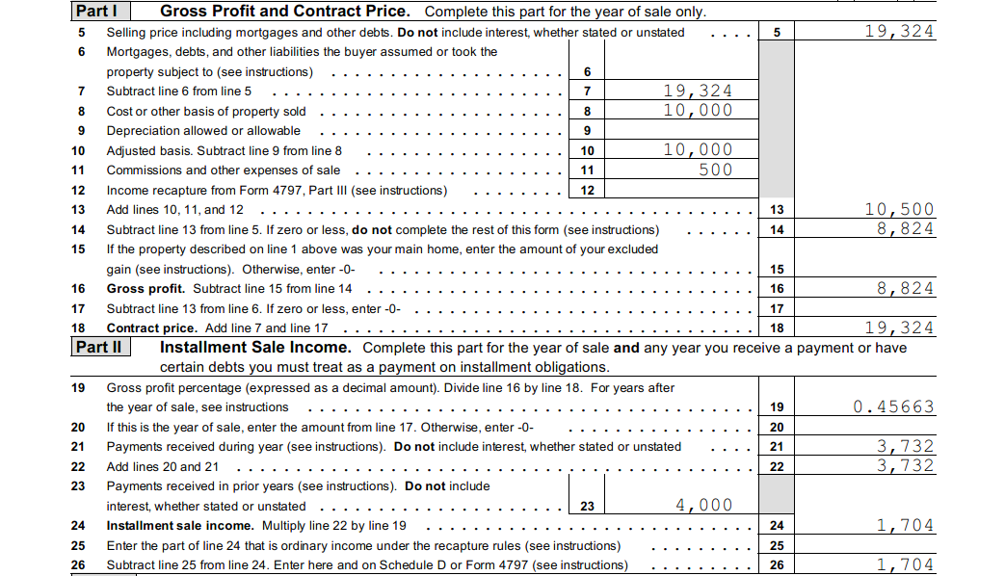
Notes:
First Installment Payment with revised Principal amount of $19,324. Down payment was $4,000 and no interest, This installment payment was calculated to be 3,732 with $268 interest.

Slide 24
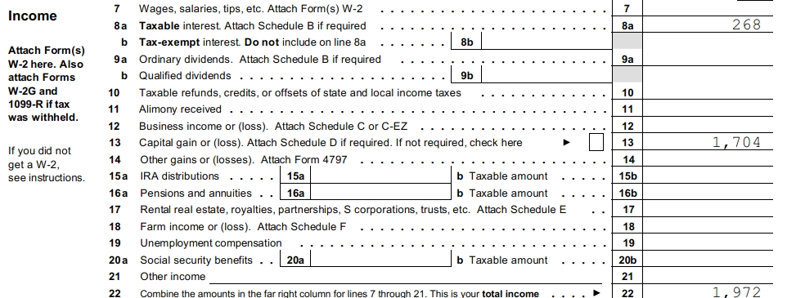
Notes:
Page 1 of the Form 1040 for the year of the first Installment Payment, 1/1/16, show that there is installment interest of $268 and a capital gain of $1,704. There is a return of capital, tax free, of $2,2028

Slide 25
Determine if Interest is Adequate
§1.483-2(a)(1)(i)
Contract does not provide for adequate interest when
  Sum of deferred payments > PV of deferred payments + PV of Stated Interest
    A sells B property under contract with $100K due at end of 10 years plus 10 annual payments of $9K.
    Test rate = 9.2%
    PV Interest = 9000/(1.092)^1+9000/(1.092)^2…..+9,000/(1.092)^10
      8241.76 + 7547.40+….3732.64 = 57,253.91
    PV Payment = 100,000/ (1.092)^10 = 41,473.78
    Total PV = 98,727.69
    Deferred Payment = $100,000 Note: There is only 1 Deferred Payment
      NOT 11 Deferred Payments
    Unstated interest = $1,272.31 ($100,000 - $98,727.69 )
Notes:
Example 1. Contract that does not have adequate stated interest.
On January 1, 1995, A sells B nonpublicly traded property under a contract that calls for a $100,000 payment of principal on January 1, 2005, and 10 annual interest payments of $9,000 on January 1 of each year, beginning on January 1, 1996. Assume that the test rate of interest is 9.2 percent, compounded annually. The contract does not provide for adequate stated interest because it does not provide for interest equal to 9.2 percent, compounded annually. The present value of the deferred payments is $98,727.69. As a result, the contract has unstated interest of $1,272.31 ($100,000 − $98,727.69).
You really need to differentiate between a payment which includes interest and principal vs interest only payments and 1 deferred payment.
The equation general equation to determine the Future Value of a payment is:
FVn = PV (1+i)^n
PV= FVn/ (1+i)^n

Slide 26
Compounding Period For Test Rate
§1274(b)(2)(B)
  “by using discount rate……compounded semi-annually”
§1.1274-4 Test Rate
  “(based on the appropriate compounding period)”
  Ernst & Young Tax Guide 2016
    Example page 356 Gains and Losses says you use the semi annual compounding rate
    Rate was a 2013 rate, but example date was 2015
    Payment was a yearly payment so annual compounding rate should be used
  My advice
    Be careful of examples other than examples in IRS regulations or Publications
    In general, the regulations and examples tell you how to calculate and apply the code
Notes:
a) Determination of test rate of interest -
(1) In general -
(i) Test rate is the 3-month rate. Except as provided in paragraph (a)(2) of this section, the test rate of interest for a debt instrument issued in consideration for the sale or exchange of property is the 3-month rate.
(ii) The 3-month rate. Except as provided in paragraph (a)(1)(iii) of this section, the 3-month rate is the lower of -
(A) The lowest applicable Federal rate (based on the appropriate compounding period) in effect during the 3-month period ending with the first month in which there is a binding written contract that substantially sets forth the terms under which the sale or exchange is ultimately consummated; or
(B) The lowest applicable Federal rate (based on the appropriate compounding period) in effect during the 3-month period ending with the month in which the sale or exchange occurs.
(iii) Special rule if there is no binding written contract. If there is no binding written contract that substantially sets forth the terms under which the sale or exchange is ultimately consummated, the 3-month rate is the lowest applicable Federal rate (based on the appropriate compounding period) in effect during the 3-month period ending with the month in which the sale or exchange occurs.

Slide 27
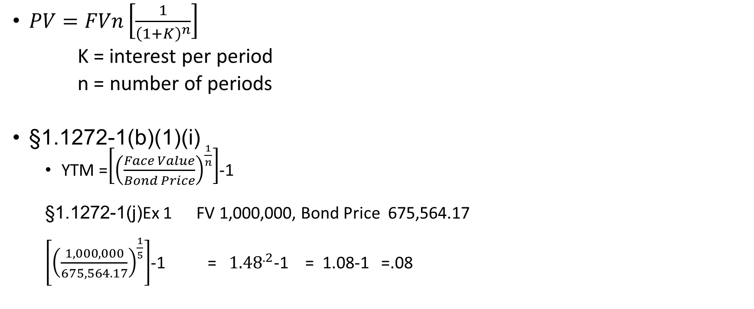
Calculations
$PV=FVn\left[\frac{1}{{\left(1+K\right)}^{n}}\right]$
K = interest per period
n = number of periods
§1.1272-1(b)(1)(i)
  YTM =$\left[{\left(\frac{Face Value}{Bond Price}\right)}^{\frac{1}{n}}\right]$-1
  §1.1272-1(j)Ex 1 FV 1,000,000, Bond Price 675,564.17
  $\left[{\left(\frac{1,000,000}{675,564.17}\right)}^{\frac{1}{5}}\right]$-1 = ${1.48}^{.2}$-1 = 1.08-1 =.08
Notes:
In the example in the regulations, I could not see how the YTM was determined based on the information. I finally had to do a search to find this formula from boundless.com. Probably you won’t have to use.
Example 1. Accrual of OID on zero coupon debt instrument; choice of accrual periods.
(i) Facts. On July 1, 1994, A purchases at original issue, for $675,564.17, a debt instrument that matures on July 1, 1999, and provides for a single payment of $1,000,000 at maturity.
(ii) Determination of yield. Under paragraph (b)(1)(i) of this section, the yield of the debt instrument is 8 percent, compounded semiannually.
1.1272-1(b)(1)(i)
(b) Accrual of OID -
(1) Constant yield method. Except as provided in paragraphs (b)(2) and (b)(3) of this section, the amount of OID includible in the income of a holder of a debt instrument for any taxable year is determined using the constant yield method as described under this paragraph (b)(1).
(i) Step one: Determine the debt instrument's yield to maturity. The yield to maturity or yield of a debt instrument is the discount rate that, when used in computing the present value of all principal and interest payments to be made under the debt instrument, produces an amount equal to the issue price of the debt instrument. The yield must be constant over the term of the debt instrument and, when expressed as a percentage, must be calculated to at least two decimal places. See paragraph (c) of this section for rules relating to the yield of certain debt instruments subject to contingencies.

Slide 28
Related Party
Client sold property to related party but did not inform you
Client’s return filed on 4/15/2015
Related Party sold property on 4/1/15 for $22,500
Related Party informed Client on 7/4/15
Caution:
  If the related party has a transaction which diminished the risk of loss, the 2 year period is suspended §453(2)(B)
Notes:
Once you have knowledge of a related party sale, you have to ask questions about the related party. First relates to Stock sales….holding a put. 2nd covers holding a right for another to purchase the property. 3rd is a short sale.
Related Person
1. A person whose stock would be attributed under §318(a) [Constructive ownership of stock]; spouse, children, grandchildren, and Parents
(b) Relationships The persons referred to in subsection (a) are: (1) Members of a family, as defined in subsection (c)(4);
(2) An individual and a corporation more than 50 percent in value of the outstanding stock of which is owned, directly or indirectly, by or for such individual;
(3) Two corporations which are members of the same controlled group (as defined in subsection (f));
(4) A grantor and a fiduciary of any trust;
(5) A fiduciary of a trust and a fiduciary of another trust, if the same person is a grantor of both trusts;
(6) A fiduciary of a trust and a beneficiary of such trust;
(7) A fiduciary of a trust and a beneficiary of another trust, if the same person is a grantor of both trusts;
(8) A fiduciary of a trust and a corporation more than 50 percent in value of the outstanding stock of which is owned, directly or indirectly, by or for the trust or by or for a person who is a grantor of the trust;
(9) A person and an organization to which section 501 (relating to certain educational and charitable organizations which are exempt from tax) applies and which is controlled directly or indirectly by such person or (if such person is an individual) by members of the family of such individual;

Slide 29
Preparer’s Responsibility
Once you know that a related party sold within the 2 year period
Advise client
  Circular 230 §10.21
  NAEA Code of Ethics Rule 7
Fraud Penalties
  No Statute of limitations §7454(a)
  75% penalty on portion attributed to fraud §6663
Advise Amending the return
  4/15/15 and maybe others if he did not disclose on original sale
Notes:
§ 10.21
Knowledge of client’s omission.
A practitioner who, having been retained by a client with respect to a matter administered by the Internal Revenue Service, knows that the client has not complied with the revenue laws of the United States or has made an error in or omission from any return, document, affidavit, or other paper which the client submitted or executed under the revenue laws of the United States, must advise the client promptly of the fact of such noncompliance, error, or omission. The practitioner must advise the client of the consequences as provided under the Code and regulations of such noncompliance, error, or omission
7. Members and associates will not knowingly misrepresent or omit information when preparing or approving and filing tax returns, documents, affidavits, and other papers relating to Internal Revenue Service (IRS) matters. If a client insists on the misrepresentation or omission, the Member or Associate should withdraw and refuse to prepare the return or other documents.

Slide 30
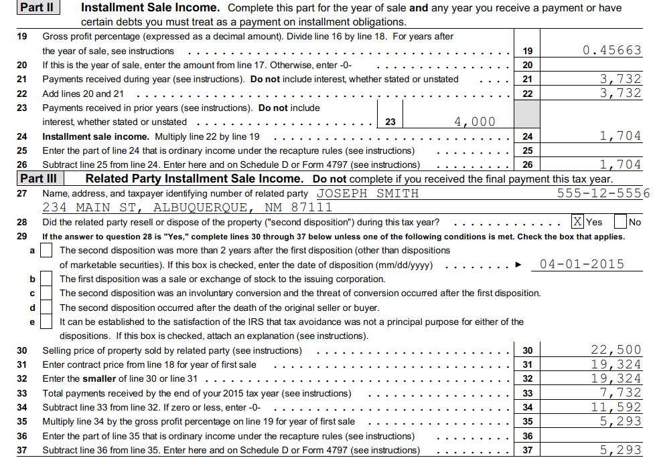
Notes:
The Taxpayer must report extra income because the related party sold the land within the 2 year time period. The calculation is the Gross Profit % X the ( lesser of the original or subsequent sale contract) – Total payments received.
In this case, the original is the smaller of the 2 and the Taxpayer received $7,732 already leaving a balance of 11,592.

Slide 31
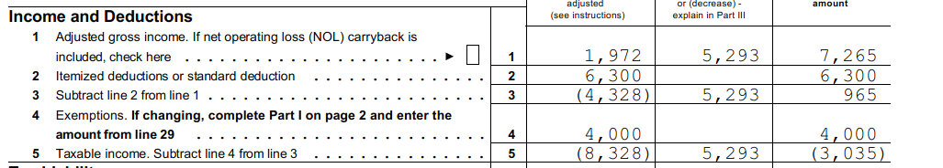
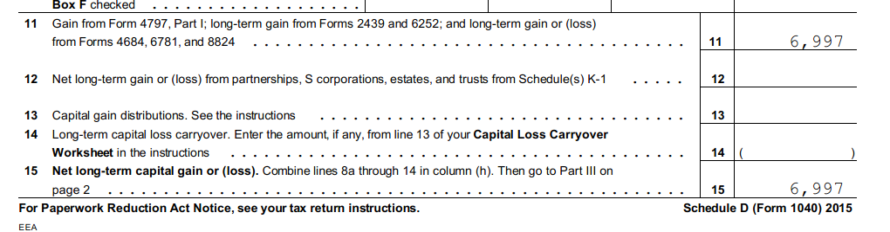
Form 1040-X
Schedule D
$6,997 = $1704 + $5,293 (Installment Sale + Gain from early Disposition by Related Party)
Character of Gain…..Long Term….remains the same with related party disposition
Notes:
§453(e)(1)(b) ….. the amount realized with respect to such second disposition shall be treated as received at the time of the second disposition by the person making the first disposition.
Thus the character of the gain on the 2nd disposition is the same as the character of the gain on the original installment sale.

Slide 32
Depreciation Recapture
Gain from sale of §1245 is ordinary to extent gain created by depreciation
  Lesser of recognized gain or
  Total accumulated depreciation
§1250 recapture only if Short Term or property subject to additional depreciation over Straight Line
  Corporations subject to §291
 | Trade or Business
Long-Term | §1231
§1231 Assets Consist of Three Types
Pure §1231 | §1245 | §1250
Land | Personal Property and Intangibles | Depreciable Real Property

Slide 33
Residential Rental Installment Sale
Rental purchased 1/1/11 $100K bldg. $25K land
Sold 12/31/15 $160K
  20 year, 5% interest, 1stof 20 payments Dec 31, 2016
    $12,839 Payment which includes $8,000 Interest
Schedule E, Form 1040 Filer
Residential Rental is §1250
  There is no accelerated depreciation currently
    If an error, Need to File Form 3115 Change of Account Method
    Revenue Proc 2015-13 provides extensive guidance

Slide 34
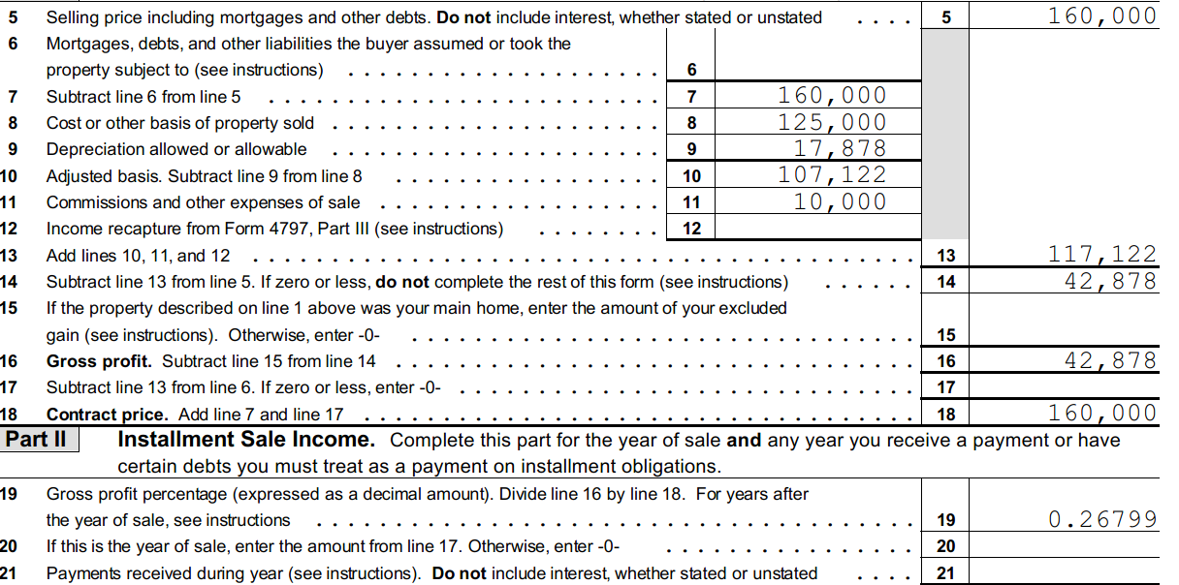
Year of Sale had no payment. Info entered to calculate Gross Profit %

Slide 35
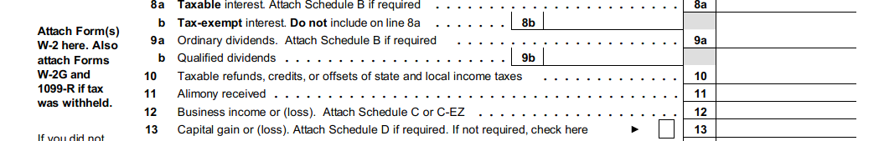

Slide 36
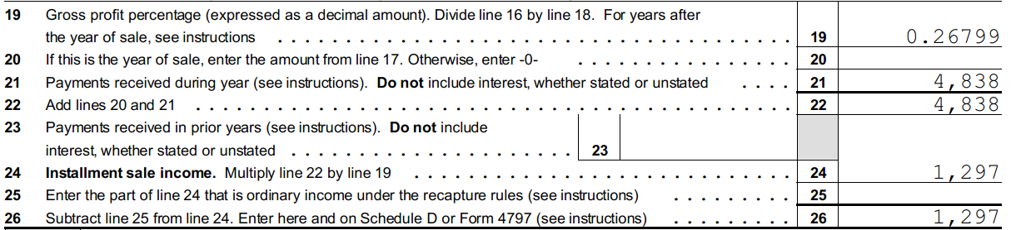
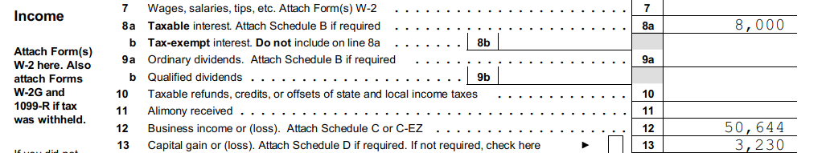
Form 6252
Form 1040 pg 1
1st Payment in subsequent tax year.
1.297
Notes:
Sorry …my mistake

Slide 37
Depreciation Recapture § 1245
Taxpayer sold Machinery on Installment Agreement 6/1/15
First Pmt 12/31/15
$8,000 of which $ 2,000 Interest
Gross Sales Price | $ 50,000
Cost | $100,000
Depreciation allowed | $ 86,613
Adj Basis | $ 13,387
Gross Profit | $ 36,613

Slide 38
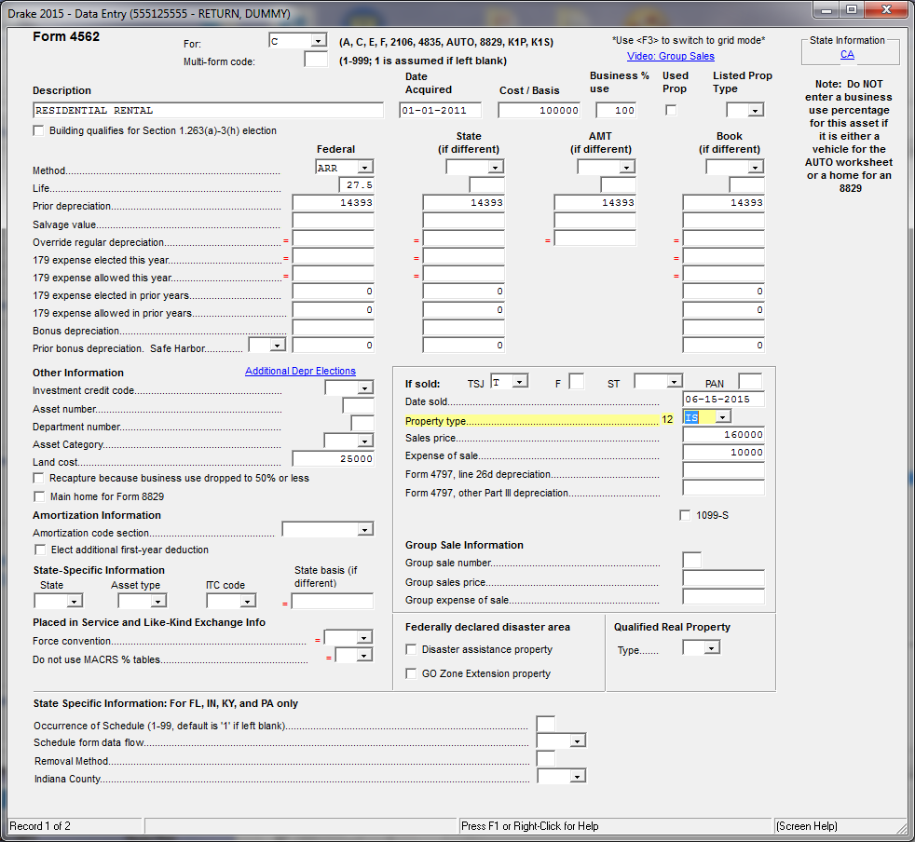
Select the correct property type:
And the sale type.
Drake has ~24 types
§1250 ≠ IS §1250
Likewise §1245 ≠ IN §1245

Slide 39
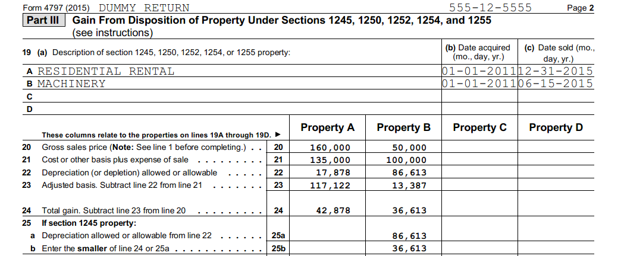
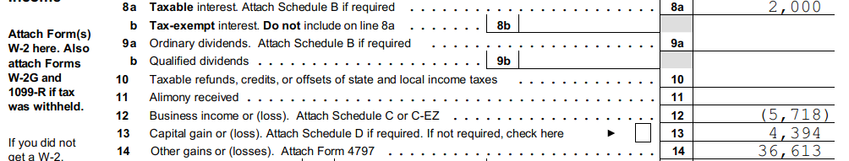
Lesser of
Notes:
§1245 recapture is ordinary income. It is the lesser of the gain or accumulated depreciation. Here the lesser is the gain of $36,613.

Slide 40
C Corp Installment Sales
Same info as previously shown for Form 1040
  Machinery with depreciation recapture §1245
  Residential Rental Sold on Installment Sale §1250

Slide 41
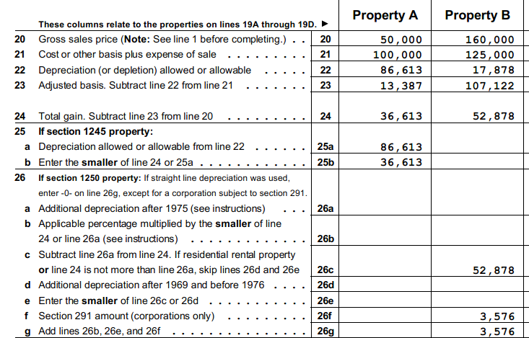
C corp 4797
Property A is §1245
  Recapture is < gain or Acc Dep
Property B is §1250
  §291 Recapture
  Manually Calculate
    20% of lesser of gain or Acc Dep
  Sell using 4797, not 4562
Total Ordinary income $40,189
Notes:
In Drake, for a C corp, you have to sell a §1250 Asset on 4797 and manually calculate the §291 recapture.
On the installment sales, you have to say to take the interest to the Form 1120. The other option, is that it goes to Schedule K for Tax exempt interest.

Slide 42
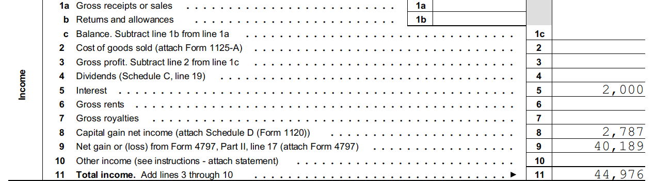
C corp 1120
2 Installment sales with $1K interest each
And Installment payments $1,322 & $1,465

Slide 43
References
Revenue Act of 1926 http://constitution.org/uslaw/sal/044_itax.pdf
Revenue Act of 1939http://constitution.org/uslaw/sal/044_itax.pdf 8/9/2016
InternalRevenueCodeof1954http://constitution.org/uslaw/sal/068A_itax.pdf 8/9/2016
Installment Sales Revision Act of 1980.PUBLIC LAW96-471—OCT.19, 1980 1980 https://www.gpo.gov/fdsys/pkg/STATUTE-94/pdf/STATUTE-94-Pg2247.pdf retrieved 8/9/2016
Installment Sales Revision Act of 1980, Herbert J Learner http://scholarship.law.wm.edu/cgi/viewcontent.cgi?article=1495&context=tax retrieved 8/9/2016

Slide 44
http://scholarship.law.wm.edu/cgi/viewcontent.cgi?article=1495&context=tax 8/11/16 1980 Act
www.boundless.com/finance/textbooks/boundless-finance-textbook/bond-valuation-6/valuing-bonds-68/calculating-yield-to-maturity-using-the-bond-price-310-1033/ 8/10/16
https://apps.irs.gov/app/picklist/list/federalRates.html
Besley, Scott, and Eugene Brigham. Essentials of Managerial Finanace. 13th ed. Mason: South-Western, 2005
http://www.naea.org/about-naea/governance/code-ethics-rules-conduct
Professional Equities, Inc. v Commissioner, 89 TC 165
Stonecrest v. Commissioner 24 TC 659

Slide 45
Liquerman, Robert and Di Franco, Diane (1987) eTax Consequences of Wraparound Mortgages, Journal of Civil Rights and Economic Development Vol 2, Iss 2, Article4, retrived 8/17/2016 http://scholarship.law.stjohns.edu/cgi/viewcontent.cgi?article=1624&context=jcred

