Slide 1
Community Property Taxation Laws
What’s mine is mine. What’s yours is mine too.
John Niemi, EA, MAcct
Notes:
My father and mother were born in the first decade of the 20th century in the Northern Peninsula of Michigan, a common law state.
My father was urban with a college education and teaching credential. My mother was a farm girl who had to quit high school to get a job…she became a nurse.
One of my earliest remembrances of something my father said was the quote on the cover. I always thought that was a joke between my parents until I prepared for this class. I think all humor has some element of truth.
I was an army brat, but basically lived in California from about 3rd grade until my wife and I moved to New Mexico in 1981. When Cindy and I were dating, I provided most of the money for dates, food, etc. We shared finances from the very beginning.
The saying became, What’s mine is mine….and what’s mine is yours too. In essence, that is Community Property.

Slide 2
Brief History of Community Property Laws
Babylon, Egypt, & Greece had some features of Community Property
Many Community Property “States” derive laws from Rome
With Manus
Without Manus
Origin of our Community Property Laws from Germanic Customs and Folk Laws
Notes:
Babylon, Egypt, Greece, & had some features of Community Property
2000 BC – 600 AD
Code of Hammurabi protected wives
138. If a free man wishes to divorce his wife who has had no children, he must pay her a settlement equal to the value of the gifts he gave her father when they were married plus the dowry she brought from her father's house; by paying this settlement he divorces her. 139. If the free man had given her father no gifts, this part of his settlement shall amount to one-half kilogram of silver. 140. If the man is a civil-servant, he shall pay one-sixth of a kilogram of silver. 141. If a free man's wife wishes to divorce him, the man may divorce her and give her no settlement. If the man does not wish to divorce her, he may marry another woman and keep his first wife in his house as a slave. 142. If a woman wishes to divorce her husband and refuses him sexual rights, an inquiry shall be held. If she has not committed adultery but her husband has, she may take her dowry and return to her father's house
Grecian Code of Gortyn (Crete) 450 BCE
IV. If a husband and wife be divorced, she shall have her own property that she came with to her husband, and the half of the income if it be from her own property, and whatever she has woven, the half, whatever it may be, and five staters, if her husband be the cause of her dismissal; but if the husband deny that he was the cause, the judge shall decide. . .
Roman Law
Many Community Property “States” derive laws from Rome
With Manus
Wife subject completely to Husband
No “wifely” possessions
No Common Fund Held Jointly
Without Manus
Wife could hold separate property > She kept her property and only contributed her dowry to husband
legal independence
No need for Community Property since W had effective control over her property.
Origin of our Community Property Laws from Germanic Customs and Folk Laws
Roman origins
Evolved until wife had right to inherit gifts from father and property from Husband
“Immovables” protected
Essentially 2 ownership estates
Germanic Tribes influenced by Rome in 300 to 400ish AD
Started out “with manus”
Wife technically “owned”, but husband had absolute control.
Husband denied right to sell “immovables” without wife consent
Much of the source material on the history of Community Property was written in the late 1800s to approximately 1965 or so. Much of the language of the documents are politically incorrect by today’s standards, but were relevant during the period.

Slide 3
History Continued
Evolution of Legal Community by Goths
Acquets
Wife received 1/3 of Acquets + personal property upon divorce
Medieval Period ( 476-1500 AD)
Collective Estate
Notes:
Evolution of Legal Community by Goths
Started out similar to Roman “with Manus”
Wife completely subject to husband
Eventually evolved until she had right to inherit property from father’s estate as well as gifts
H had absolute control, except for immovables. She had to agree to dispose of them.
Essentially 2 estates: Husband’s and Wife’s
Evolved to:
Acquets
Property acquired during marriage by labor
Did not include inheritances
Wife received 1/3 of Acquets + personal property upon divorce
Medieval Period ( 476-1500 AD)
Collective Estate
Community in the Collective Hand: Wife’s property united with H’s forming an Invisible Whole…rights subject to collective ownership.
Wife had same rights of ownership in Husband’s property as he in hers
Agreements could limit property included
Husband still in control

Slide 4
Modern Times
German Civil Code of 1900
Uniform code of laws
3 Community Systems Allowed by Marriage Contract
General Community Property
Community of Income and Profits
Community of movables
Notes:
German Civil Code of 1900
Uniform code of laws
3 Community Systems Allowed by Marriage Contract
General Community Property
All property of spouses
Common Property regardless of how acquired except by agreement
Community of Income and Profits
Constituted exclusively by earnings and profits and income accruing to the spouses during marriage
All other property considered Separate Property
Community of movables
All movables at marriage plus acquired during marriage
Immovables remained separate property

Slide 5
Origins of Spanish Law
Goths ➔ Visigoths
Migrated to Iberian Peninsula
Code of Euric
Community of Matrimonial Gains
2nd Visigothic Code
AKA Fuero Juzgo
Beginning of Spanish Law
http://www.themiddleages.net/visigoths.html
Notes:
Goths ➔ Visigoths
Germanic Tribes invaded Rome periodically. Eventually a peace of sorts existed. Rome was weak and split into Eastern Rome with capital in Constantinople and the Western Roman Empire with Rome as capital. Goths migrated during this period due to pressures from Eastern raiders and eventually migrated to the Iberian Peninsula and acted as surrogates for Roman rulers. With the fall of the roman empire in 476, the Goths formed their own kingdom.
Migrated to Iberian Peninsula
Western Roman Empire
Aided in Roman Control
Own Kingdom after Fall
Code of Euric
First marital community ~466 AD
~ 660 AD
Community of Matrimonial Gains
Acquets divided per share contributed
693 AD
2nd Visigothic Code
AKA Fuero Juzgo
Beginning of Spanish Law
The Franks to the north were antagonists of sorts with friction and warring.
In 711, Muslims invaded Spain and ruled much of the Iberian Peninsula for 700 years. Between 1000 and 1200, Christian Kingdoms began to invade and reconquer Spain. Granada was the last to fall in 1492.

Slide 6
Spanish Law Continued
Wife’s property protected at dissolution
Community was not mandatory
Wife could renounce Husband’s maladministration
Recodifications of Spanish Law
Spanish Civil Code of 1889
Notes:
Wife’s property protected at dissolution
Pro Rata at first
Equal Share
Community was not mandatory
Modified by written contract
Wife could renounce Husbands maladministration
Not held liable for mismanagement and debt
Preserved separate property
Recodifications of Spanish Law
500 year gap between Fuero Juzgo and 1st of many recodifications
1567 Recopilación essentially defined present day Community Property Laws
Spanish Civil Code of 1889
Essentially just a recompilation of previous codes
Recodifications of Spanish Law occurred in
1255 Fuero Real
1263 Las Siete Partidas
Leyes del Estilo
From 1492 to 1750’s, there were continual laws to account for the various colonies/possessions.

Slide 7
France
Franks migrated into Northern and NE France from Germany
Area controlled by Franks continued community property laws
Normandy controlled by decedents of Norse warriors
Northern rules with Community Property vs Southern Laws of Roman Origin
Code Napoleon 1804
Notes:
Franks migrated into Northern and NE France from Germany
Area controlled by Franks continued community property laws
Community of movables and acquets
Husband controlled most
Could not dispose of jointly acquired immovables
Husband continued to gain power and could dispose of immovables
Wife got right of renunciation
Normandy controlled by decedents of Norse warriors
1066 invaded & conquered England
Allied with the various rulers of the French Kingdoms
Normans ruled England and fought for control of what they believed rightly theirs, some of France
England conquered Normandy in 1418
Essentially “ England controlled this part of France until thrown out at end of 100 years war. ~1453
Northern rules with Community Property vs Southern Laws of Roman Origin
Code Napoleon 1804
Community of movables and acquets
All the movables at time of marriage plus what was acquired.
Fruits of labor community property
Immovables acquired during marriage Community Property

Slide 8
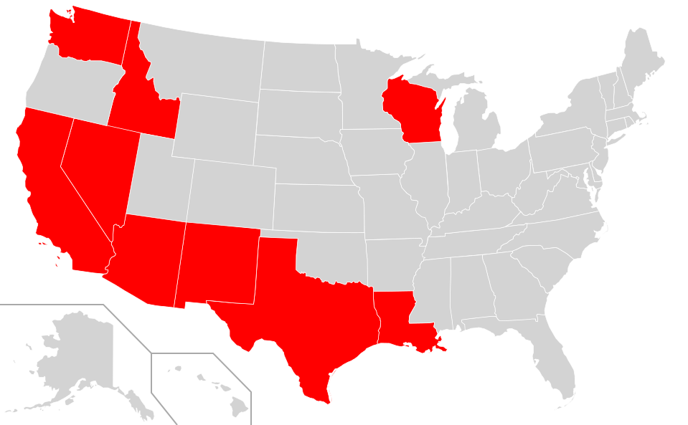
Community Property States
Washington
California
Nevada
Arizona
New Mexico
Texas
Louisiana
Wisconsin
Idaho
Alaska by election
Territories
Guam, Puerto Rico
https://en.wikipedia.org/wiki/Community_property
Notes:
Decidedly influenced by the Conquest of the Americas by Spain.
Louisiana settled by French with La Salle in 1682. French customary laws included community property laws of France and charters required French Laws to be followed. Code Napoleon.
Ceded to Spain after French Indian Wars 1763. Spain applied their laws and therefore community property laws. Returned to France in 1800 with the signing of the 3rd Treaty of San Ildefonso. Because the territorial boundaries were not defined, when France sold the Louisiana Territories to the US in 1803, the US and Spain had disagreements on what was included.
France did not take possession until 20 days before the sale to the US. No reintroduction of French Laws occurred.
Puerto Rico and Guam from Spanish American War of 1898
What’s with Wisconsin? Elected to enact Community Property Laws on 1 Jan, 1986. Patterned after the Uniform Marital Property Act. IRS has ruled in Rev Ruling 87-13 that Wisconsin’s law is essentially community property law.
Texas Constitution contains its Community Property System
What happened to Oregon? Ruled by British and only became the Oregon Territory after the 1846 Oregon Treaty

Slide 9
Classes of Community Property States
Traditional…..under Spanish Rule
California 1850
Texas 1836
Louisiana 1808
New Mexico 1884
Arizona 1865
Unique…..not under Spanish or French Rule
Idaho 1867
Washington 1869
Nevada 1864
Uniform Marital Property Act
Wisconsin 1986
Voluntary
Alaska 1998
Notes:
Try to explain why there are differences.
Traditional Classes are from the Spanish rule. Louisiana is a little different because the were controlled by both France and Spain, but Spanish Community Property Rules predominate even though Code Napoleon is the basis of much of the other civil codes.
Voluntary. Alaska Community Property Act Alaska Stat §34.77.0609a)
Uniform Marital Property Act
1963 President’s Commission on the Status of Women
Those who supported the Equal Rights Amendment (first introduced in Congress soon after women won the right to vote in 1920) believed with the restrictions and special privileges of women workers under protective legislation, employers were motivated to higher fewer women or even avoid hiring women altogether.
Unique:
Idaho….California miners migrating East brought California’s CP system. Idaho did not want Mormons polygamy
Washington….from California Statutes of 1850
Nevada adopted Community Property Laws when Gold and Silver discovered and California miners migrated

Slide 10
Who Really Cared?
Stakeholders
Tax Levied according to 1924 Rev Act
Wives
Settlers
“There aren’t many women out here”
Advocates for Women’s Rights
Property rights
Voting Rights
Married Couples in all states after Feb 3, 1913
$100,000 income in Common Law State
$17,020 Tax Liability
2 x $50,000 incomes Community Property State
$7,080
~ $10,000 difference
($136,720 in 2016)
http://www.saving.org/inflation
Notes:
When I first began to assembly the course work for this class, I thought only history of community property and how it came to exist in the new world. I read the words from the historians covering Europe, Mesopotamia, and Greece and thought boy they treated women differently.
When I read the portion about France and that Normandy was not included in the Frank’s system of Community Property, I thought…well that is because England is the basis of common law etc. etc.
The first stakeholder was of course the wife. Of course, the wife would like community property system for the reason’s outlined in the “brief history”. I skipped right to the next person. The Settler’s.
I never really comprehended the state of American Women in the early 1800’s until I had to do a little research on the comments “there aren’t enough women out here”. And what might attract women to the west.
The article Women’s Rights Before the Civil War shocked me.
In the 18th and 19th century, American Law based on English Common Law and the doctrine of coverture.
Coverture held that no female person had a legal identity. At birth, a female baby was covered by her father’s identity, and then, when she married, by her husband’s. The husband and wife became one–and that one was the husband. As a symbol of this subsuming of identity, women took the last names of their husbands. They were “feme coverts,” covered women. Because they did not legally exist, married women could not make contracts or be sued, so they could not own or work in businesses. Married women owned nothing, not even the clothes on their backs. They had no rights to their children, so that if a wife divorced or left a husband, she would not see her children again.
according to Dr. Catherine Allgor, Prof History UC Riverside.
Ownership of the wife’s property passed to her husband upon marriage.
A married woman could not:
Control property that was hers before marriage
Keep or control wages she earned
Acquire property while married
Transfer or sell property
Bring a lawsuit
Make a contract
Women Rights activists always equated to voting rights to me. However, voting rights were just the means to make representatives responsive to women for the injustices of what English Common Law inflicted on the women of the day.
In 1848, the first Women’s Rights Convention was held in Seneca Falls, NY. Lucretia Mott and Elizabeth Cady Stanton hosted the Convention and issued the Declaration of Sentiments, the wording based loosely on the Declaration of Independence. The preamble closes with :
“But when the long train of abuses and usurpations, pursuing invariably the same object evinces a design to reduce them under absolute despotism, it is their duty to throw off such government, and to provide new guards for their future security. Such has been the patient sufferance of the women under this government, and such is not the necessity which constrains them to demand the equal station to which they are entitled.”
Settlers understood they had to make the West attractive to women. In Women of the West, Virginia Scharff says “ Who could have predicted in 1869, the chaotic Territory of Wyoming……would see railroad workers, prospectors, and gold miners…elect a territorial legislature that gave women the right to vote for the very first time in American History”…
In fact only 4 states prior to 1900 gave women the right to vote; One a community property state, Idaho (WY UT CO).
Western territorial and state legislatures enacted measure that led the way to women’s rights, including holding elected offices.
So who else cared?
When the 16th Amendment became law, Congress enacted a tax on every individuals income.

Slide 11
Community Property & the Federal Income Tax
Initially No Guidance
Tax on “net income of every individual”
All community income deemed to be the income of the husband
By ownership according to state law
Income from community property was community income
Separate income of husband after marriage and separate property was not community property.
Treasury Decision 3138 for Personal Income Tax
Treasury Decision 2450 for Estate Tax
Notes:
What is income? To whom does the income belong? In community property states, the H&W claimed ½ of the total (exc California) California law was the prior to 1917 that the husband was the absolute owner of community property. United States v. Robins
Initial Ruling abandoned in 1919. A bit of trivia, prior to 1919, Treasury Rulings were not public, thus there were no numbers associated with them as there are today.
Income from property which generated the income
Not the ownership of the funds or the property which generated the income
First applied to property acquired after marriage for Texas and Washington
TD 3138
March 3, 1921
All states except California, community income has been treated as one-half the income of the husband and one-half the income of the wife.
“A husband and wife domiciled in Arizona, Idaho, Louisiana, Nevada, New Mexico, Texas, or Washington, in rendering separate income tax returns, may each report as gross income one-half of the income which, under the laws of the respective States, becomes simultaneously with its receipt community property.” Position abandoned in 1920
In California, the California Courts ruled that the wife has a mere expectancy during the life of the husband
Office Dec. 426, 13-20-815, Cum. Bul. No. 2, p. 198
“the legal owners of community property (property acquired after marriage) in the States of Texas and Washington are the husband and wife jointly in equal shares, and the income accruing therefrom is the joint income of the husband and wife in which each is entitled to one-half.”
Poe v. Sanborn, 282 U.S. 101 (1930)
“The Commissioner concedes that the answer to the question involved in the cause must be found in the provisions of the law of the State, as to a wife's ownership of or interest in community property.”
In the intervening years the US had lots of issues. WWI, Depression, WWII. With FDR the rates continued to climb. War Bonds and Taxes were necessary to fund the government. Significant burden on the highest earners.
Pay as you go was introduced in Revenue Act of 1943. Prior to that , citizens had to pay by March 15, the entire tax bill. However that was pretty burdensome. Reason was for income smoothing, and to make it seem to the average joe….taxes were less than they really were.

Slide 12
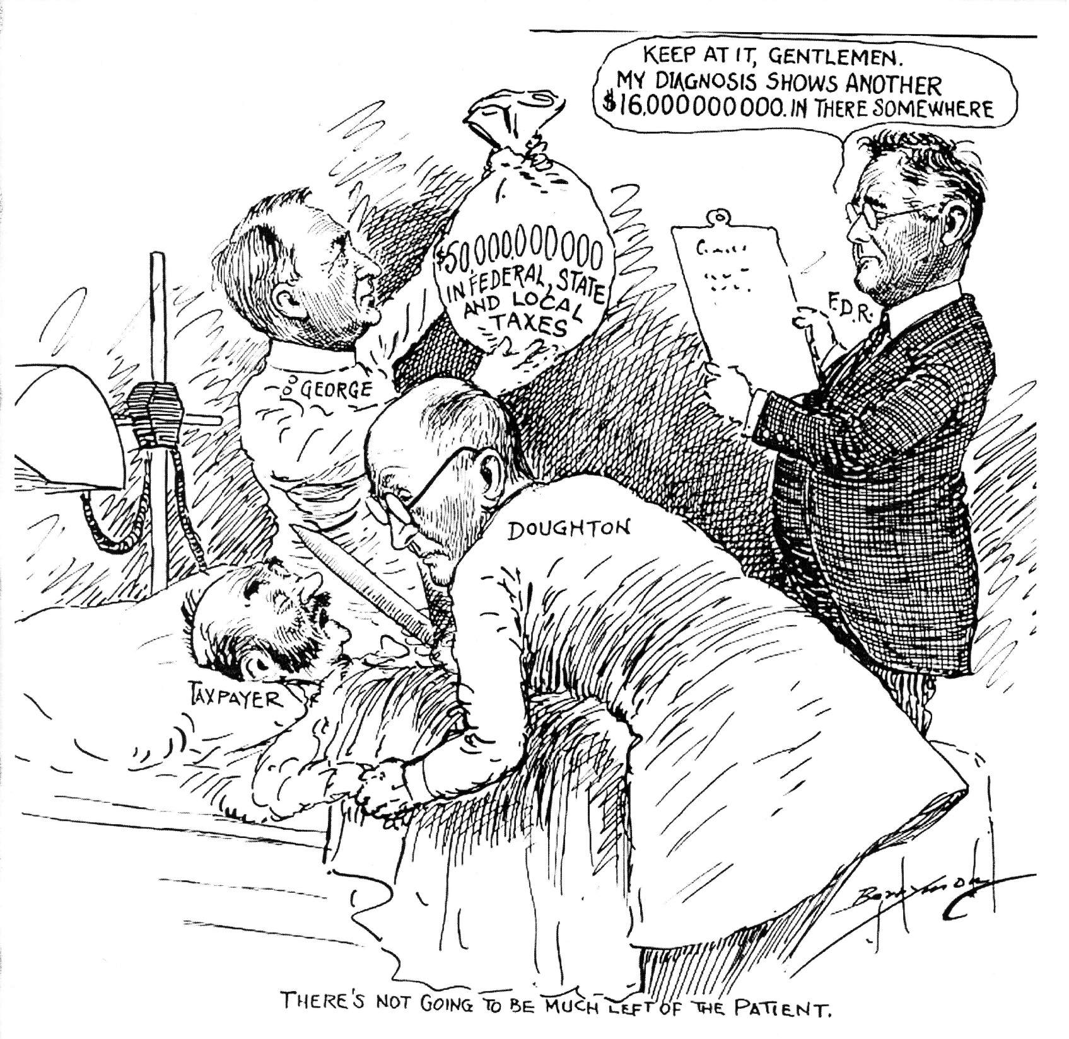

Slide 13
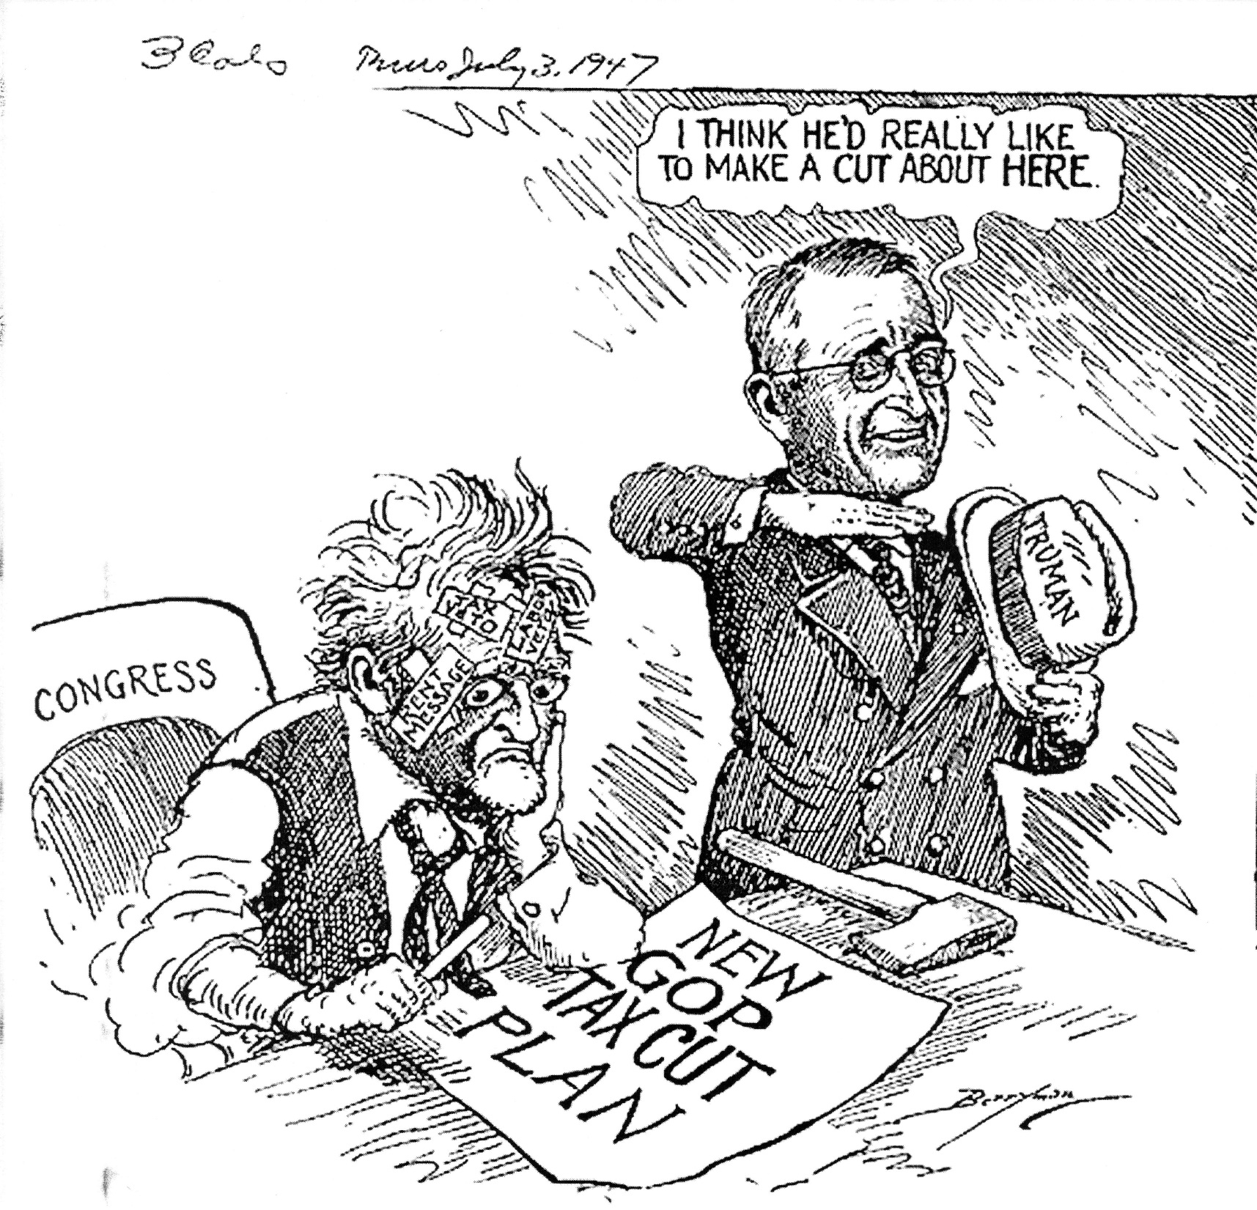

Slide 14
Revenue Act of 1948
Community Property vs Common Law Fight continued
Legislation proposed and failed from 1924-1942
1948 Revenue Act
Reduce taxes on top tier from 94%
Adopted Split-Income Method
Equalized Federal tax treatment of married couples
Truman vetoed but overridden
Notes:
In various forms the House and Senate proposed changes to the law to equalize treatment of Common Law States with Community Property States.
1921. House passed a revenue bill that had all income be included on the separate return of the spouse with management control. This failed in the Senate and was not resurrected.
Taxation of the community manager were made in 1924,1934, and 1941.
Compulsory Joint returns were proposed in 5 various sessions of congress. 1933, 1934, 1937, 1941, and 1942. All failed
GOP controlled congress. And after the war had ended, there was a strong desire to reduce taxes.
Congress did however, eliminate the advantage of community property states in the estate tax before 1948.
“Income splitting is effected by permitting husbands and wives to file a joint return. In such a return the
Combined tax-able income is divided by two, the tax is then computed and multiplied by two in order to determine the total tax.”
Various safeguards were put in place to keep the field level:
Std Deductions MFJ $1,000, but MFS $500.
H&W no longer had to live together to file MFJ.
Determination as to when married at close of tax year.
Person legally separated under decree of divorce or separate maintenance is not married.
Non Resident Aliens disqualified from Joint Returns
Same Taxable year
A surviving spouse who remarries can’t file a joint return with deceased spouse, but can with new spouse.
Previously, splitting income only applied to community income. Separate income had to be included on separate return.
The ACT now applies to all income. For the first time California families could gain the benefits. Recall, the California Rule, Separate income from separate property. With joint returns, this is not an issue.
Another advantage is the right to offset capital gains of one spouse against the losses of the other by combining the income and losses in a joint return.
Elect to file Jointly. Revocation only until the expiration of the filing period. Election made each tax year.
Tax liability is joint and severable. That is , there is no pro rata apportionment of liability due to the separate incomes.
Form 1040 for 1948 has a question at the bottom of page 1:
Is your wife (or husband) making a separate return for 1948? Y or N.

Slide 15
Current Community Property Concerns
Termination of the Marital Community
Validity of Agreements
Clarification of Income during separation period
Treatment of Income from Separate Property
Common Law Marriage
Tax minimization through separate returns
Notes:
These are my beliefs.
Are there others that you might consider?

Slide 16
Do Community Property Laws Apply?
Legally Married
Traditional
Common Law
Same Sex
Domestic Relationships
CA
NV
WA
WI
Domiciled in Community Property State
Intent
Not equivalent to Residence
Facts and Circumstances
Once established is presumed to continue.
Notes:
Common Law Marriages
Alabama, Colorado, District of Columbia, Iowa, Kansas, Montana, Rhode Island, South Carolina, Texas, Utah
Many states repealed Common Law Marriages. In particular Idaho repealed in 1996, but recognizes CLM prior to repeal.
Many States will recognize validity of Common Law Marriages if the marriage began and was valid in a common law marriage state.
New Mexico follows the Federal Filing rules and recognizes Common Law Marriages if Valid elsewhere.
3.3.12.12. FILING STATUS; TAXPAYER NAME:
A. A taxpayer filing a New Mexico income tax return shall use the same filing status for New Mexico purposes as for federal purposes for the taxable year. Spouses using the status "married filing jointly" for federal purposes must use the same status for New Mexico purposes; those using the status "married filing separately" for federal purposes must do likewise for New Mexico.
Review Exhibit 25.18.1-1 from the IRM
Domestic Partners in CA, NV, WA subject to state community property laws and required to split income on separately filed tax returns. Registered Domestic Partners may not file joint returns.
WI allowed a declaration of domestic partnership. Does not subject them to WI marital property statutes. They don’t report income under community property laws.
Post the 16th Amendment and the Revenue Act of 1948, you can imagine the contortions that taxpayers used to domicile in a community property state.

Slide 17
Domicile
Actual Residence is required
Place where you intend to return
Entrance into military does not necessarily change domicile
Factors
Where you pay state income tax
Where you vote
Location of property you own
Citizenship
Length of residence
Business and social ties to community
Notes:
Prior to the Revenue Act of 1948, there were lots of attempts for common law couples to be domiciled in a community property state. Some of the cases took years to wind their way thru the courts, so the dates on the case may be later than the Revenue Act.
Sanders v. Sanders (Pa. Super. Ct. 1944)
Domicile of origin is presumed to continue until another state domicile has been acquired by actual residence coupled with intention of abandoning the domicile of origin: Price v. Price, 156 Pa. 617, 626, 27 A. 291. The proof of a change of domicile does not depend upon any particular fact but upon whether all the facts taken together tend to establish a new, fixed and permanent residence.
Petition of Oganesoff, (S. D., Cal.) 20 F.2d 978; 28 C. J. S. 33. 1927 Residence case to satisfy immigration rule of residing in us for 5 years.
Immigrant came from Armenia and lived in US. Wife and family stayed in Armenia. Wife move to Mexico. Oganesoff visited often in Mexico….came and went from US. When applied for residency, it was denied.
“The presumption is that a married man's residence is where his family resides, when the family resides at a permanent home and no separation has taken place. Gaddie v. Mann (C. C.) 147 F. 955; Cadwalader v. Howell, 18 N. J. Law, 138; Gilbert v. David, 235 U.S. 561, 35 S.Ct. 164, 59 L. Ed. 360; Bangs v. Brewster, 111 Mass. 382; Sheehan v. Scott, 145 Cal. 684, 79 P. 350. The domicile or residence of origin of the petitioner was in the land of his birth. Delaware, etc., Railway Co. v. Petrowsky (C. C. A.) 250 F. 554.
When a residence or domicile is once acquired, it continues until a new one takes its place. It is not lost merely by temporary absence, or temporary residence elsewhere, though that may be continued for a period of years. It is well settled that the domicile of origin easily reverts when lost, and for that reason is an important factor in determining actual residence.
Silvas v. United States 205 F.2d 444 (5th Cir. 1953)
The trial court found that although Sivalls intended to make his domicile in Fort Worth, Texas, he did not couple this intent with actual residence there until July, 1946, and concluded that he was not domiciled in Texas during the years in question; that he was not entitled to the tax benefits of the community property laws of that state; and was not entitled to the refund sued for. These legal conclusions were properly applied to the facts.
PENTLAND v. COMMISSIONER OF INTERNAL REVENUE 11 T.C. 116 (T.C. 1948)
Applying the established principles of law as to domicile to the essentially undisputed facts here, we find a situation which may be briefly summarized as follows: Petitioner, while serving in the military forces of the United States, was detailed for duty at a military air base near Fort Worth, Texas; he rented a house and established his family in the latter city; he opened a checking account, rented a safe deposit vault, where he kept his securities, established credit accounts with local merchants, joined social clubs, made some investments in oil properties, and voted at least once, in an election in 1944 when he became qualified to do so. All of such facts, with the exception of voting, evidence a conduct both natural and consistent with temporary residence. The more so, since petitioner was financially well off and enjoyed a large annual income. Of course, the self-serving declarations of petitioner that he intended to change his domicile to Forth Worth are to be weighed in the light of all the circumstances.
Petitioner belonged to several social clubs in Florida. He did not resign his membership. The reason given was that membership fees were waived in the case of members who were in the military service. Even so, we think that, if petitioner intended to abandon his established domicile in Florida, the natural impulse would have been to so inform his social associates. Other evidence which we think has an important bearing on petitioner's intention is the fact that within two weeks of his discharge from the military service he placed his household goods and personal effects in storage and left for Florida; he claimed and received from the Government the expense of his transportation back to Florida; and, having returned to Florida, he remained there.
Earlier in this opinion we referred to the fact that petitioner, on at least one occasion, voted in the election while living in Fort Worth. Although "voting" is important evidence on the issue of domicile, it is not decisive if all the circumstances lead to an opposite conclusion. District of Columbia v. Murphy, 314 U.S. 441, 456.
Smith v Smith 206 Pa. Superior Ct. 310 (1965) Divorce Case.
By domicile is meant the place where a person has his true, fixed, permanent home and principal establishment, to which whenever he is absent he has the intention of returning

Slide 18
Examples
John and Cindy, residents of NM, decided to move to Holland for a job. They rented their ABQ house and kept bank accounts open. In Holland, they opened new bank accounts, learned Dutch, and worked for 3 years. They made new social ties to Holland. They intended to return to ABQ after their 3 year contract was completed.
Carly and Mike were California residents. Carly took a job in Switzerland and moved to Zurich to teach. Mike remained in California. Carly’s employment contract and residence visa was for 1 year, but was renewed for an additional year. She returned after 15 months.
Chris and his family transferred from ABQ to Texas at the request of his employer. Chris rented his house, and relocated. He obtained a new bank account, DL. Marital problems resulted in returning to ABQ 1 year and a month after moving to Texas.
Notes:
John and Cindy changed domiciles. They intended to live in Holland, even though they kept their ABQ bank and house. John’s son attended school in Holland. They paid Dutch taxes and filed a US tax return with Foreign Income Exclusions.
Carly paid Swiss taxes. She did not buy a car or get a new license. The contract was “short term” and she failed to meet the residency test for income exclusion. Her husband remained in California. Her intent was always to return to California to be with her husband. Carly did not change domiciles.
Chris moved and returned to ABQ due to marital problems. Shortly after returning, Chris and his wife divorced. Upon returning, Chris filed his NM tax return as 1st year Resident. NM TRD may challenge Chris’s intent.

Slide 19
Marital Community
Begins when a legally married couple is domiciled in a community property state.
Marry in a Community Property State
Move into a Community Property State
Example
John and Annie Smith were married in Denver on Valentine’s Day, 2012. They moved to ABQ June 1, where John opened a music store and Annie taught school. The Marital Community began on June 1, 2012
Bill and Bob were ABQ residents their entire lives. They lived together as a couple beginning in 2011 and comingled funds. On July 4, 2015 they married by a Methodist minister. The Marital Community began on July 4.
Betty and Grace were ABQ residents who were married on vacation in California on July 4, 2008. (before Prop 8). The Marital Community began ???
Notes:
Bill and Bob were legally married because SCOTUS ruled same sex marriage was legal.
Betty and Grace were married in California before the SCOTUS ruling. They could not file a joint return for Federal Tax Purposes, therefore they filed as single. Thus the marital community did not begin until June 15, 2015.
In 2008, had they been California Residents they would have filed :
Same-sex married individual or registered domestic partners (RDPs) who file single for federal must file married/RDP filing jointly or married/RDP filing separately for California.
Therefore the marital community began July 4, 2008.
OK….I am not a lawyer so I can’t give you legal advice. This is my opinion only, but if I had to separate community property from separate property…I would use the 2008 date.

Slide 20
Marital Community Continues
John and Annie Married in 2004 in New Mexico. In 2006 they moved to Denver with intent to change domiciles. They lived in Denver until 2012 when Annie’s parents died. John and Annie moved to Arizona and remain there.
Marital Community
2004-2006
2012-2016
Non-marital Community
2007-2011
Notes:
This become very important during divorce cases. If John has a pension, then Annie may be entitled to some of the pension/retirement.

Slide 21
Termination of Marital Community
Death
Change of Domicile
Divorce or Legal Separation
Final decree of dissolution or legal separation
All but California and Washington
Physical Separation
Intend to permanently end the marriage
Mutual intent
Facts and Circumstances
Annulment
Never subject to community property laws
Assets are Divided between Spouses
Notes:
A final decree can not be made retroactive to a prior completed tax year for federal income taxes. See Brent v. Commissioner, 630 F. 2d 356 (5th Cir. 1980).
“Once again we consider the plight of a Louisiana ex-wife who is assessed with an income tax deficiency on one-half of that part of her former husband's community earnings received by him prior to the termination of the marital community and never paid to her. Concluding that Louisiana law made the income belong to the spouses in equal shares and, therefore, permits the imposition of the tax, we reverse the contrary conclusions of the Tax Court, 70 T.C. 775, and remand for further proceedings.”
“The mere filing of a divorce petition in Louisiana makes no change in the community. Only the divorce decree effects its termination. On December 31, 1970, the community between Mrs. Brent and Dr. Brent was still in existence. On that date she owned one-half of the community income, although her ownership was potentially subject to divestiture, and, in accordance with the annual accounting principle, she was taxable on what she then owned. This is the teaching of Mitchell. The final divorce decree was not a pro forma recognition of a state of facts that actually existed on the day the petition was filed. The entry of the final decree was an act of independent significance that terminated the community when it was entered. Although the decree is given retroactive effect, under the annual accounting principle effective in federal tax cases, it did not alter the federal tax treatment of income earned in a prior year.

Slide 22
Division of Marital Property after Termination
Equal vs Equitable
Community Property vs Common Law States
Presumed equal division in Community Property States
Allowance from spouse's separate property as alimony.
Allowance for Child Support
Joint Income until termination, Separate Income after
Income between separation and termination depends on state
Notes:
In New Mexico:
40-3-10 Priorities for satisfaction of separate debts
A. The separate debt of a spouse shall be satisfied first from the debtor spouse's separate property, excluding that spouse's interest in property in which each of the spouses owns an undivided equal interest as a joint tenant or tenant in common. Should such property be insufficient, then the debt shall be satisfied from the debtor spouse's one-half interest in the community property or in property in which each spouse owns an undivided equal interest as a joint tenant or tenant in common, excluding the residence of the spouses. Should such property be insufficient, then the debt shall be satisfied from the debtor spouse's interest in the residence of the spouses, except as provided in Subsection B of this section or Section 42-10-9 NMSA 1978. Neither spouse's interest in community property or separate property shall be liable for the separate debt of the other spouse.
B. Unless both spouses join in writing in the creation of the underlying debt or obligation incurred after the marriage, a judgment or other process arising out of such post-marital debt against one spouse alone or both spouses shall not create a lien or otherwise be subject to execution against the interest of the nonjoining spouse in the marital residence, whether held by the spouses as community property, joint tenants or tenants in common.
40-3-11 Priorities for satisfaction of community debt
A. Community debts shall be satisfied first from all community property and all property in which each spouse owns an undivided equal interest as a joint tenant or tenant in common, excluding the residence of the spouses. Should such property be insufficient, community debts shall then be satisfied from the residence of the spouses, except as provided in Subsection B of this section or Section 42-10-9 NMSA 1978. Should such property be insufficient, only the separate property of the spouse who contracted or incurred the debt shall be liable for its satisfaction. If both spouses contracted or incurred the debt, the separate property of both spouses is jointly and severally liable for its satisfaction.
40-4-7. Proceedings; spousal support; support of children; division of property.
B. On final hearing, the court:
may allow either party such a reasonable portion of the spouse's property or such a reasonable sum of money to be paid by either spouse either in a single sum or in installments, as spousal support as under the circumstances of the case may seem just and proper, including a court award of:
40-4-14. Allowance in property; appointment and removal of guardian.
In proceedings for the dissolution of marriage, separation or support between husband and wife, the court may make an allowance of certain property or properties of either party or of both parties for the maintenance, education and support of the minor children of the parties, and may vest title to the part of the property so allowed in a conservator appointed by the court. The conservator must qualify and serve in such capacity as provided in Sections 5-101 through 5-502 [ 45-5-101 to 45-5-502 NMSA 1978] of the Probate Code.
Joint income vs Separate Income depends on state and the laws regarding separation vs divorce. CA and WA, separation before divorce continues community income.
4A-102 Petition for dissolution of marriage (without children) :
7. Any Community Property of the parties should be equitably divided.
8. Any Community Property Debts of the parties should be equitably divided

Slide 23
Effect of Physical Separation on Income
No change
Idaho
Wisconsin
Separate Income
California
Louisiana
Separate Income with Written Agreement
Arizona
Nevada
New Mexico
Texas
Separate Income if no intent to unite
Washington
Notes:
Use the Table 25.18.1-1 from the IRM.

Slide 24
Characterization of Property
Defined by each State
URLs are provided at end of presentation
NM 40-3-8. Classes of property
Separate
Community
Quasi-Community Property
IRM definition is different
For probate and other purposes
Little or no impact on basic principles of Community Property Income Taxation
Quasi-Community Property ≠ Community Property
Notes:
40-3-8A. "Separate property" means:
(1) property acquired by either spouse before marriage or after entry of a decree of dissolution of marriage;
(2) property acquired after entry of a decree entered pursuant to Section 40-4-3 NMSA 1978, unless the decree provides otherwise;
(3) property designated as separate property by a judgment or decree of any court having jurisdiction;
(4) property acquired by either spouse by gift, bequest, devise or descent; and
(5) property designated as separate property by a written agreement between the spouses, including a deed or other written agreement concerning property held by the spouses as joint tenants or tenants in common in which the property is designated as separate property.
B. Except as provided in Subsection C of this section, "community property" means property acquired by either or both spouses during marriage which is not separate property. Property acquired by a husband and wife by an instrument in writing whether as tenants in common or as joint tenants or otherwise shall be presumed to be held as community property unless such property is separate property within the meaning of Subsection A of this section.
C. "Quasi-community property" means all real or personal property, except separate property as defined in Subsection A of this section, wherever situated, heretofore or hereafter acquired in any of the following ways:
(1) by either spouse while domiciled elsewhere which would have been community property if the spouse who acquired the property had been domiciled in this state at the time of its acquisition; or
(2) in exchange for real or personal property, wherever situated, which would have been community property if the spouse who acquired the property so exchanged had been domiciled in this state at the time of its acquisition.
D. For purposes of division of property incident to a dissolution of marriage or a legal separation under Section 40-4-3 NMSA 1978, quasi-community property shall be treated as community property, if both parties are domiciliaries of New Mexico at the time of the dissolution or legal separation proceeding.
E. "Property" includes the rents, issues and profits thereof.

Slide 25
Separate Property
Acquired before the Marital Community
Acquired with separate funds
Wages in non-Community Property States
Gifts or Inheritances
Property converted from Community Property by agreement
Once classified as separate property it remains separate property
Traceable
Comingling without adequate records converts separate to community
Notes:
Military Pensions or other pensions while in Common Law states.

Slide 26
Examples
Real property
Bob purchased rental in Colorado before marriage.
Bob and Susan marry and move to New Mexico
Rental Property is Bob’s separate property
Inheritance
Bob and Susan are married in New Mexico
Susan’s father dies and leaves his rentals to Susan
Susan’s rentals are separate property
Savings/Investments
Susan saved 25% of wages prior to marriage ($50,000)
Susan’s savings are separate property if traceable
Conversion by Agreement.
Bob deeds his Colorado rental to Susan and agrees it is her Separate Property

Slide 27
Community Property
Real Property Governed by State Where Located
Example:
Bob and Susan purchased rentals while domiciled in New Mexico
Bob and Susan move to Colorado
Rentals remain Community Property
Example:
Bob and Susan purchase rentals in Colorado
Rentals in Colorado are Separate Property

Slide 28
Examples for Separate Returns
John and Cindy are legally married and domiciled in a Community Property State. John has wages of $40,000 and Cindy has wages of $20,000. Their interest from their joint savings account is $150.
If they file separate returns:
John Cindy Total Separately
$40,000 $20,000 $60,000 $30,000 150 75
$30,075

Slide 29
Juan and Juanita are domiciled in New Mexico. They married on September 1 this
year. Juan earned $2,000 per month all year. Juanita had no income.
Juan Juanita
January thru August Separate Income $16,000 0
Sept thru December Community Income $ 4,000 $ 4,000
$20,000 $4,000
Pat and Roberta were domiciled in Texas from January until July 1st. They moved to
Colorado where they lived for the remaining months of 2015. Pat’s salary for the year
was $2,000 per month. Roberta earned $3,000 per month.
Pat Roberta
January thru June Community Income $15,000 $15,000
July thru December Separate Income $12,000 $18,000
$27,000 $33,000

Slide 30
Income From Separate Property
Separate Income California Rule
Arizona
California
New Mexico
Nevada
Washington
Community Income Texas Rule
Idaho
Louisiana
Texas
Wisconsin
Mixture of both in 1st and last year of marriage in CP states
Notes:
In general, income from separate property is separate. However, in the TEXAS Rule states, the income from separate property is classified as community income in most instances.
Comingling of funds may result in community income regardless of the initial rule.

Slide 31
Examples Income from Separate Property
William and Mary are domiciled in Wisconsin. Mary purchased shares in Harley
Davidson before they married. In 2015 Mary received $900 in Dividends. Because
they reside in Wisconsin, income from separate property is community property
(Texas Rule), on separate returns they would each report $450 Dividend Income.
If they lived in Nevada (California Rule), Mary would report $900 Dividend Income
and William would report $0 Dividend on their separate returns.

Slide 32
Income from Sale of Separate Property
Proceeds from the sale of separate property is separate income
Appreciation is Separate Income
Rental H previously owned and then sold
Increase in value due to community labor is Community Income
Flip a house which H owned previously but both repaired

Slide 33
Comingled Funds
Comingled funds, if traceable, are separate property
Comingled funds not traceable are community property
Items purchased with comingled funds which are traceable are a mixture of separate and community property
Example:
George and Martha are domiciled in New Mexico. They bought a rental house in Rio Rancho for $100,000. Martha’s savings from before they were married ($30,000) was combined with their joint savings of $70,000.
Martha owns (30,000 + 35,000)/100,000 65%
George owns 35,000/100,000 35%

Slide 34
Income from Rio Rancho Rental
Income from Rental $12,000
Expenses of Rental $ 6,000
California Rule
On separate Returns:
George (35%) Martha (65%)
Income $ 4,200 $7,800
Expenses < 2,100 > < 3,900>
Net $ 2,100 $ 3,900
Texas $6,000 $6,000
<3,000 > <3,000>
Net $3,000 $3,000

Slide 35
Federal Preemption
Savings Bonds
National Service Life Insurance
Railroad Retirement Benefits
By extension Social Security Benefits
Federal Pension and Retirement Benefits are Community Property
IRA withdrawals
Earned Income Credits
Self Employment Taxes
Notes:
Free v. Bland, 369 U.S. 663 (1962)
H & W bought Savings Bonds with CP. Wife died. Son from different marriage was beneficiary. H claimed all savings bonds as his right and according to treas regs. Son brought suit for ½ interest. Texas is Community Property State and ½ of the bonds belonged to wife….therefore inherited by son.
Syllabus
By virtue of the Supremacy Clause of the Constitution, the Treasury Regulations creating a right of survivorship in United States Savings Bonds registered in co-ownership form preempt any inconsistent provision of the Texas community property law. Pp. 369 U. S. 664-671.
(a) The Treasury Regulations which provide, inter alia, that, when a savings bond is registered in co-ownership form, i.e., payable to one person "or" another, a co-owner who survives the other co-owner "will be recognized as the sole and absolute owner" of the bond, and that "No judicial determination will be recognized which would . . . defeat or impair the rights of survivorship conferred by these regulations," constitute a valid federal law within the meaning and intent of the Supremacy Clause. Pp. 369 U. S. 666-668.
(b) A provision of the Texas community property law which, in effect, prohibits a married couple from taking advantage of the survivorship provisions of these regulations merely because the purchase price of the savings bonds is paid out of community property conflicts with the federal regulations on this subject, and must fall under the Supremacy Clause. Pp. 369 U. S. 667-671.
Wissner v. Wissner, 338 U. S. 655.
Our holding is supported by Wissner v. Wissner, 338 U. S. 655. There, the Congress made clear its intent to allow a serviceman to select the beneficiary of his own government life insurance policy regardless of state law, even when it was likely that the husband intended to deprive his wife of a right to share in his life insurance proceeds, a right guaranteed by state law.
Syllabus
An insured under a National Service Life Insurance policy, who was domiciled in California, as was his wife, designated his mother as principal beneficiary and his father as contingent beneficiary. Premiums on the policy were paid from the insured's Army pay. Since his death, the proceeds of the policy were being paid to his mother in monthly installments. The insured's widow brought suit in a California court, alleging that, under the state community property law, she was entitled to one-half the proceeds of the policy. The court gave judgment to the widow for one-half of the payments already received and required payment to her of one-half of all future payments immediately upon receipt thereof.
Held:
1. The judgment of the state court was invalid as in conflict with the National Service Life Insurance Act of 1940. Pp. 338 U. S. 656-660.
(a) Under 38 U.S.C. § 802(g), the proceeds of such a policy belong to the named beneficiary, and the judgment below would nullify the soldier's choice and frustrate the purpose of Congress. Pp. 338 U. S. 658-659.
(b) So far as it ordered diversion of future payments, the judgment contravenes the provision of 38 U.S.C. § 454a that payments to the named beneficiary
"shall be exempt from the claims of creditors, and shall not be liable to attachment, levy, or seizure by or under any legal or equitable process whatever, either before or after receipt by the beneficiary. . . ."
Hisquierdo v. Hisquierdo, 439 U.S. 572 (1979)
Syllabus
The Railroad Retirement Act of 1974 (Act) provides retirement benefits for railroad employees. The benefits are not contractual and can be altered by Congress at any time. Benefits for an employee's spouse terminate upon an absolute divorce. 45 U.S.C. § 231d(c)(3). Except for satisfying child support or alimony obligations,
"no annuity [under the Act] shall be assignable or be subject to any tax or to garnishment, attachment, or other legal process under any circumstances whatsoever, nor shall the payment thereof be anticipated. . . ."
45 U.S.C. § 231m. Petitioner, a California resident whose years of service as a railroad employee entitled him to benefits under the Act if and when he attained age 60, petitioned for dissolution of his marriage to respondent, also a resident of California, which has a community property law. The trial court divided the parties' community property, but held that respondent had no interest in petitioner's expectation of receiving railroad retirement benefits. The Supreme Court of California ultimately reversed, holding that, because the benefits would flow in part from petitioner's employment during marriage, they were community property. The court rejected petitioner's contention that § 231m barred respondent's claim, reasoning that the provision was intended to apply to creditors only.
Held: Benefits payable under the Act may not be divided under the community property law. Pp. 439 U. S. 581-590.
10 US Code §1408 says that for pension benefits after 6/25/81, the pension benefits are community property.
c)Authority for Court To Treat Retired Pay as Property of the Member and Spouse.—
(1)
Subject to the limitations of this section, a court may treat disposable retired pay payable to a member for pay periods beginning after June 25, 1981, either as property solely of the member or as property of the member and his spouse in accordance with the law of the jurisdiction of such court.
Bunney 14 T.C. 259
Petitioner (H) and his former wife (W) were divorced in 1992. H and W were residents of California, a community y property State. The judgment dissolving the marriage ordered that H’s IRA’s, which were funded with contributions that were community property, be divided equally between H and W. In 1993,Hwithdrew$125,000from his IRA’s and transferred$111,600 to W. Held: sec. 408(g), I.R.C., precludes characterization of W as a 50-percent “distributee” of H’s IRA’s under sec. 408(d)(1), I.R.C.; accordingly, H,notW, is taxable on the distributions. Held, further ,no portion of the $111,600 paid to W is excludable from
H’s income under sec. 408(d)(6), I.R.C. Held, further ,H is liable for the sec. 72(t), I.R.C., additional taxon theIRA distributions. Held, further, petitioner had a reasonable basis for his position, and thus the accuracy-related penalty for negligence under sec.6662(a), I.R.C., applies only with respect to the
adjustments conceded by H.

Slide 36
Marital Agreements
Agreements to recharacterize Community or Separate Property
Generally written
Prenuptial Agreements in all Community Property States
Postnuptial Agreements in all Community Property States
Pending Divorce
All but Idaho and Louisiana
Can assign future income without transfer of interest in property
Notes:
Prenuptial agreement might stipulate that the income from H’s separate property is the separate income of W.
Stock is H separate property. Dividends are assigned to W as her separate Income.
Agreements can be voided if the treatment of the property is different. For example comingling of funds or treating separate property as community property.

Slide 37
Jurisdiction
Personal Property acquired while domiciled in a state retains the character of that state
Wages
Investments
Real Property is governed by State of Situs regardless of domicile
Rental Income from New Mexico Property is community income regardless where couple is domiciled
Real Property acquired with separate funds is separate property
Notes:
Johnson v. Commissioner, 7BTA 820, 1927
“we cannot think it was the intention of the Legislature that no distinction should be made between property acquired wholly within this state by the joint efforts of husband and wife and property acquired by them elsewhere and brought within this state. If it were the intent of the statute that property acquired in another jurisdiction and brought within the state should become community property, its legality might be seriously questioned. It would destroy vested rights. It would take from one of the spouses property over which he or she had sole and absolute dominion and ownership, and vest an interest therein in the other”
Real Property
Petitioner was married in 1901. Thereafter until 1915 he lived with his wife in Pomeroy, Washington, at which time the couple removed to Oregon where they have since resided.
The situation is not altered by the fact that the parties were domiciled in Oregon. The Washington laws control the status of property acquired there during coverture in the case of non-resident as *358 well as resident married persons.^{[1]} Gratton v. Weber, C.C., 47 F. 852

Slide 38
Separate Tax Returns
Generally better to file a joint return
Separate Returns
Itemize if spouse itemizes
No EIC
No Child or Dependent Care Credit
No Education Credits
No Student Loan Interest Deduction
Adoption Expense Exclusion denied
Smaller Child Tax Credit
May have to include more SS benefits
Paid Tax Prepares are expected to compare Joint & Separate for each client
Notes:
Last item is new to me.
Under IRS rules……Well I could not find it. I don’t know if everybody does this.

Slide 39
Preparing Separate Returns
Complete Form 8958 for each
Attach to each separate return
Report Half of Community Income + All Separate Income
Allocate withholdings
Self Employment Net Income Divided
SE Tax attributed to spouse who “owned” business
Extension for filing 1 MFS does not extend Spouse MFS
Notes:
Wages from Schedule C income is community income and must be split
Partnership income from the labors of either spouse is community income.
Passive income may be community or separate income.
Income in year of divorce but before dissolution is community income….see rules on separations for CA and Wisconsin
Illegal Income: Income from illegal sources is taxable James v US 366, US 213 (1961)
Property must be “acquired” by the spouse to be community property. Acquired interpreted as passage of title….thus if the victim or payor intended to pass title to the spouse, it is community property.
Johnson v Commissioner 72 TC 340 (1979). Fraudulent tax refund checks paid in name of spouse are community property. Fraudulent checks paid in name of 3rd party are separate checks.
Payment for drugs are likely community property because it was intended to pass title (ownership)
SE tax is attributed to person doing the business. Partnership income for computing SE tax is attributed to partner even if the income is community property income.
Expenses associated with income are characterized same as the income.
e.g. Income from separate property on Sch C is split, even if expenses are paid out of separate property. Finley v Commissioner T.C. Memo 1982-411. Rationale is community income is NET, not Gross.
IRA deductions are not split because they belong to 1 person

Slide 40
Exemptions
Own Exemption
Assign Dependent Exemptions
Can’t equally divide the amount
Must meet member of HH or Relationship to claim dependent
If community income used for support, need multiple support agreement
Example:
Fred and Wilma were married and domiciled in Wisconsin. Fred earned $49K and Wilma earned $62K. If they file separately, who can claim the exemption for their dependent, Pebbles?
What about if they were domiciled in Louisiana?
Notes:
Jorg v. Commissioner, 52 TC 288
In Washington, separation does not change the character of wages. Therefore all of the H & S wages were community property. Expenses for support of child were equally divided. H filed separately, but was denied the exemption for his dependent.
We conclude in accordance with our numerous prior decisions that where community expenses are paid by community funds the expenses are equally divisible between the husband and wife.
We therefore conclude that petitioner is not entitled to a dependency exemption for Robert Roy since he did not as a matter of law pay over one-half of his support for the year 1966.
Separation creates separate income in AZ, CA, LA, WA
Separation does not change income from community income in ID, NV, NM, TX, WI

Slide 41
Military Income
Domicile of Active Duty Spouse
Residence ≠ Domicile
Joe and Jane are legally married and domiciled in Kansas. Joe is in the Army. Jane is a
nurse. In June of 2012, Joe was transferred to Ft. Hood, Texas where they both live
until Joe’s enlistment is up in 2016.
None of the Income is Community Property.
Same facts, but Joe and Jane are Domiciled in Texas and then transferred to Florida to
JSOC. They intend to return to Texas.
All of the income is Community Property Income
Notes:
Active Duty
Domiciled in Community Property State
Be careful what you ask when you are preparing the return. Do they reside in a community property state or are they domiciled in a community property state?
Remember Sivalls and Pentland cases. In both cases, they were in the military. Sivalls, intended to live in Texas when he got out of the Army at the end of WWII. Pentland actually lived in Texas….even voted, but the court ruled he really was a resident of Florida.
Ask for documents which can prove domicile of your client: bank accounts, school registration, voting card, car registration, etc.

Slide 42
Other Income & Itemized Deductions
Social Security / Railroad Retirement
Workers’ Comp
Unemployment
Compensation for Lost Wages
Depends on Source used to pay expenses
Medical Expenses
Be careful of the AGI limit
Isabella and Jorge are domiciled in NM. The combined income was $50K. Isabella is 66. $4500 medical expenses were paid by community funds. On a separate return Isabella can deduct ______ for Medical Expenses
Notes:
These are community property income items
SSN, RR, Unemployment, Lost wages.
Deduction
Depends on source to pay.
In the example:
Isabella’s income $25,000. Floor is 7.5% x 25,000 = 1875
Medical Expense 2,250
Deduction =375

Slide 43
Separated Spouses Filing Separate Returns
Tests
Lived apart all year
Did not file a joint return
Had Earned Income that was Community Property Income
Did not transfer Earned Income between Spouses
Report Community Income
Earned Income to Spouse who performed services
Not Social Security
Trade or Business to Spouse Doing the Trade or Business
Partnership income to Partner
Separate Income reported to Spouse who owns Separate Property
All other income (dividends, interest, etc.) per state rules
Notes:
Earned Income: Wages, salaries, professional fees,
Social Security is individual income,

Slide 44
Example for Separated Spouses in Texas
Normally, each would report $30,500 (26,500 + 34,500)/2.
But because they met the 4 tests above they report income separately as follows:
 | Rick | Ruth
Wages | $20,000 | $22,000
Sch C | $5,000
Partner |  | $10,000
Separate | $1,000 | $2,000
Community | $500 | $500
 | $26,500 | $34,500

Slide 45
Basis of Property for Surviving Spouse
General Rule §1014(a)(1)
FMV at Date of Death or at Alternative Date
Community Property Rule§1014(b)
“,,,the following property shall be considered to have been acquired from…the decedent.”
§1014(b)(6)
“…property which represents the surviving spouse’s ½ share of community property”
½ the value must be included in Decedent’s estate
No estate tax has to be paid
Form 706 does not have to be files
Step up in Basis to FMV for both 1/2s of the Community Property

Slide 46
Basis Continued
H & W own Investment Land in Community Property State.
Basis of Property $50K
H dies, W inherits
FMV $100K
½ of FMV is included in H’s estate
H’s W’s
Basis $25K $25K
New Basis
1014(a)(1) $50K 1014(b)(6) $50K
Total New Basis $100K

Slide 47
Holding Period – Gains and Losses
W’s Interest
Date of Acquisition
Inherited Interest
Date of death
Inherited Separate Property
No actual date
Considered Long Term
Gains / Losses follow property ownership
Separate
Community

Slide 48
IRAs
Based on Separate Incomes
Limited to income or $5,500 (<50 yrs old)
Ownership depends on Laws of the Community Property State
No guidance on Roth IRA
Education IRA disregarded for Community Property Laws
Gift to student
Separate Income to Student
Notes:
Bunney 14 T.C. 259
Petitioner (H) and his former wife (W) were divorced in 1992. H and W were residents of California, a community y property State. The judgment dissolving the marriage ordered that H’s IRA’s, which were funded with contributions that were community property, be divided equally between H and W. In 1993,Hwithdrew$125,000from his IRA’s and transferred$111,600 to W. Held: sec. 408(g), I.R.C., precludes characterization of W as a 50-percent “distributee” of H’s IRA’s under sec. 408(d)(1), I.R.C.; accordingly, H,notW, is taxable on the distributions. Held, further ,no portion of the $111,600 paid to W is excludable from
H’s income under sec. 408(d)(6), I.R.C. Held, further ,H is liable for the sec. 72(t), I.R.C., additional taxon theIRA distributions. Held, further, petitioner had a reasonable basis for his position, and thus the accuracy-related penalty for negligence under sec.6662(a), I.R.C., applies only with respect to the
adjustments conceded by H.
Stafford v. Commissioner, 1997 RIA TC Memo
IRA distribution was considered community income in Texas. ½ taxed to each Spouse.

Slide 49
Estimated Taxes
Divide Payments as you see fit
All to One
Equally Split
Any ratio
If you can’t agree:
Allocated by ratio of separate tax liability to sum of tax liabilities
H tax liability $4000
W tax liability $2500
Est Tax Paid $3800
H (4000/6500) x 3800 = 2,337

Slide 50
Innocent Spouse
§6105 Relief from joint and several liability on joint return
Without regard to community property laws
Innocent Spouse
Separation of Liability
Equitable Relief
Form 8857
Notes:
Innocent Spouse, Separation of Liability, and Equitable Relief apply to MFJ couples in both Community and Common States.
6105 replaced 6103(e) in 1998.
MFJ filers with questionable spousal claims for deductions or minimization of income
Same rules as common law states
W/O regard means that any item that by would be attributed to offending spouse won’t be split due to community property laws.
Form 8857 must be filed within 2 years after the date on which IRS begins collection. Garnishment of wages or notice of intent to levy starts the 2 year
Tax Court had jurisdiction to review .
Generally more liberal after 1998 law

Slide 51
Conditions
Joint Return with understatement of tax
Taxpayer signed
Did not know
Had no reason to know
Reasonably prudent person
Indicators
Significant Benefit
Divorced or deserted by spouse
Notes:
Understatement due to erroneous items
All facts and circumstances
Erroneous items
Unreported income
Incorrect deduction, credit, or property based claimed by spouse
Reasonably prudent person would or should know under the circumstances, keeping in mind the person’s level of intelligence, education, and experience.
Knowledge of item referenced to activity no exact amount
Examples: Ollestad v. Commissioner p 95
Spouse with limited education and not involved with H business. Never had a job or filed a separate tax return. Permission to write checks.
Hardy v Commissioner
Knew H was employed, had income, and some of the income used to pay family expenses.
Significant Benefit can be direct or interact
Review pub 971 for details
McGee v Commissioner
Wife knew H was careless with financial matters. No effort to review tax returns…just signed.

Slide 52
Separation of Liability Relief
Conditions
Widowed, Divorced, Legally Separated
Not member of HH during 12 months prior to filing
Allocates Tax Liability between spouses
Election more favorable
Notes:
Not granted if:
TRANSFER of Assets. Transfer is presumed to be to avoid taxes.
Actual knowledge when signed
Tax payer has burden of proof in basis of separating
IRS has burden of proof for frauds
Klett makes the case that there is little downside to making the election if there is no fraud or disqualified transfers.
There is nothing which prevents the taxpayer with more assets to try and protects their assets.
Taxpayer should do if there is a suspicion of omitted income or questionable deductions.

Slide 53
Equitable Relief
Unfair based on Facts and Circumstances
Relief from underpayment
Community Property MFS filers
§66 Treatment of Community Income
Meet Conditions
Did not know or had reason to know
Notes:
Equitable Relief
Underpayment of Tax liability: Couple file MFJ. Owe $5K. They pay 2.5K. H & W takes out a loan to pay rest, but H buys a boat.
MFS Filers
§66
(a)
Lived apart
Did not file joint return
Earned Income which is community income
No portion of earned income is transferred between spouses
Then treated as in §879(a)
Earned income other than trade or business income assigned to spouse who rendered service
Trade or Business or Partnership assigned to the person carrying on Trade or Business or Partnership §1405(a)(5)
Separate property income to spouse owning separate income
All other community property income per community property law.
Spouse acted as if it was separate property, failed to notify other spouse of income before due date, Secretary can disregard community property laws.
Traditional Relief
(c)Only for Items of Income
Not MFJ
Did not include income as in §879(a)
Establishes spouse did not know
All Facts an Circumstances…
Then Secretary can include in other spouse’s income
From the IRM
First Sentence applies to deficiency only [ 1st sentence is (c) above]
Cannot file a joint return
Does not include community income
Community income as in 879(a) is attributed to other spouse
Did not know or have reason to know
All facts and Circumstances ….Secretary will not include income
Equitable Relief
If spouse did not qualify for Traditional Relief
Service will consider equitable relief See IRM 25.15.3.8.2 for the specific threshold requirements.

Slide 54
Injured Spouse
Form 8379
MFJ return
Obligations by one spouse
Student loans
Child or spousal support
Tax Debts
Nontax Debts
Notes:
Expected Overpayment thus a refund when some or all of the spouses community property share of the refund is expected to be used to satisfy other spouses obligations.
Overpayment first applied to unpaid joint tax liabilities, then to separately stated liabilities.
In AZ, NV, NM, WA, WI, community property is not subject o premarital or other separate debts of either spouse.
Therefore only the obligor’s community property share of the joint overpayment is subject to the offset.
In TX, it depends on who earned income. If Obligor earned all, then all of the overpayment can be offset. If Injured spouse earned all, then only 50% can be offset. If both had income, then 75% of the overpayment can be used to offset the liability.
In CA, ID, LA, 100% of the joint overpayment can be taken to pay the obligations of one spouse.
See item 15 in the IRM table 25.18.1-1
An Injured Spouse is one where MFJ return is filed and one spouse has not paid previous obligations
Child Support
Spousal Support
Federal Tax
State Tax
State unemployment compensation debts
Federal Non Tax
Student Loans
File form 1040 MFJ with Injured Spouse written on Upper Left Corner of Form 1040 and file 8379 with return.
File 8379 separately.

Slide 55
SE Income and Tax
SE Income in Community Property States is Community Income
SE Tax is assigned to spouse carrying on trade or business
Rick & Ruth each report $10,000 SE income on Separate Return
Rick Reports SE Tax of $2,886 on his separate return
 | Rick
Net SE Income | $20,000
Taxable SE Income | $18,470
SE Tax | $2,826
SE Tax Deduction | $1,412.96
Notes:
SE income is 20K
SE x 92.35%
SE Tax = 15.3% X Taxable SE income
Deduction is ½

Slide 56
Retirement Benefits
Military Retirement
Based on domicile when earned
SSgt Smith 20 yr. retirement was ½ community property
$10,000 retirement is divided
$5,000 separate
$2,500 his share of community property
Civil Service Retirement
Similar Pro Rata
(Years in Community Property State/ Years Worked) X Pension = % Community
Notes:
10K total retirement pay.
SSGT Smith would report $7,500 Retirement Income
EX Wife would report $2,500
Calculation: (10 yrs in CP / 20 yrs worked) X Pension= ½ x 10,000 = $5,000 Separate and $5,000 Community Property Income
Of the community ½ is his 2,500 Community
total 7,500

Slide 57
S Elections in Community Property States
§1362(a)((2)
requires signature of all shareholders of an S corp on day of election
§1.1362-6(b)((2)(i)
Stock is jointly owned by spouses in Community Property State
Revenue Proc 2004-35 Provides Relief
If valid for all other reasons except spouse signature
File with correct service center
Statement that Spouse consents to the election
Both taxpayers identifications
Reported all income properly
Notes:
.01 Eligibility for Automatic Relief. Automatic relief is available if all of the following conditions are met:
(1) The S corporation election is invalid solely because the Form 2553, Election by a Small Business Corporation, failed to include the signature of a community property spouse who was a shareholder solely pursuant to state community property law; and
(2) Both spouses have reported all items of income, gain, loss, deduction or credit consistent with the S corporation election on all affected federal income tax returns.
.02 Procedural Requirements for Automatic Relief. The corporation must file with the service center with which the corporation files its income tax return a dated statement that includes the following information:
(1) A representation that reads, “This statement is being furnished pursuant to Rev. Proc. 2004-35 for a late filing of shareholder consents for community property spouses of S corporation shareholders in community property states.”
(2) The name of the corporation, its employer identification number, its address, date of incorporation, state of incorporation, and the intended effective date of its initially filed Form 2553;
(3) Each spouse’s name, social security number or employee identification number, tax year end and the total number of shares owned at the date of the intended election;
(4) A statement that the community property spouses reported all items of income, gain, loss, deduction or credit consistent with the S corporation election on all affected returns;
(5) A signed statement from each of the community property spouses that reads, “Under penalties of perjury, I, [name of community property spouse], declare that I consent to the election to treat [name of S corporation] to be an S corporation under section 1362(a) of the Internal Revenue Code as of [the date that the S corporation intended to be an S corporation] and to the best of my knowledge and belief, the facts presented in support of this election are true, correct, and complete.”

Slide 58
Business Entity Solely Owned in Community Property State
Husband Owns business in New Mexico
Community Property State ➔ Wife owns ½ interest
Revenue Proc 2002-69
Business is not a corporation under §301.7701-2
Wholly owned by husband and wife in Community Property State
No person other than one or both spouses considered owner
Service will respect choice
Disregarded Entity
Partnership
File Form 8832 to change
Notes:
§301.7701-2(a)
Business entities. For purposes of this section and § 301.7701-3, a business entity is any entity recognized for federal tax purposes (including an entity with a single owner that may be disregarded as an entity separate from its owner under § 301.7701-3) that is not properly classified as a trust under § 301.7701-4 or otherwise subject to special treatment under the Internal Revenue Code. A business entity with two or more members is classified for federal tax purposes as either a corporation or a partnership. A business entity with only one owner is classified as a corporation or is disregarded; if the entity is disregarded, its activities are treated in the same manner as a sole proprietorship, branch, or division of the owner.
§301.7701-3
(a) In general. A business entity that is not classified as a corporation under § 301.7701-2(b) (1), (3), (4), (5), (6), (7), or (8) (an eligible entity) can elect its classification for federal tax purposes as provided in this section. An eligible entity with at least two members can elect to be classified as either an association (and thus a corporation under § 301.7701-2(b)(2)) or a partnership, and an eligible entity with a single owner can elect to be classified as an association or to be disregarded as an entity separate from its owner. Paragraph (b) of this section provides a default classification for an eligible entity that does not make an election. Thus, elections are necessary only when an eligible entity chooses to be classified initially as other than the default classification or when an eligible entity chooses to change its classification.
(b) Classification of eligible entities that do not file an election -
(1) Domestic eligible entities. Except as provided in paragraph (b)(3) of this section, unless the entity elects otherwise, a domestic eligible entity is -
(i) A partnership if it has two or more members; or
(ii) Disregarded as an entity separate from its owner if it has a single owner.
(c) Elections -
(1) Time and place for filing -
(i) In general. Except as provided in paragraphs (c)(1) (iv) and (v) of this section, an eligible entity may elect to be classified other than as provided under paragraph (b) of this section, or to change its classification, by filing Form 8832, Entity Classification Election, with the service center designated on Form 8832. An election will not be accepted unless all of the information required by the form and instructions, including the taxpayer identifying number of the entity, is provided on Form 8832. See § 301.6109-1 for rules on applying for and displaying Employer Identification Numbers.

Slide 59
Summary
Revenue Act of 1948 equalized tax burden for all married couples
Separate Returns
Divorce
Separation
Legal Issues
Prior Tax debts
Joint Returns for Community Property similar to Common Law
Ask clients to provide time lines for states in which they lived
Refer to Laws of State where domiciles

Slide 60
Important Court Cases
Poe v Sanborn, 282 U.S. 101 (1930)
Morgan v. Commissioner, 309 US 78 (1940)
Black v. Commissioner of Internal Revenue, 114 F.2d 355 (9th Cir. 1940)
Hisquierdo v. Hisquierdo, 439 U.S. 572 (1979)
Saunders v. Saunders, 38 A.2d 730 (Pa. Super. Ct. 1944)
Petition of Oganesoff, (S. D., Cal.) 20 F.2d 978; 28 C. J. S. 33.
Notes:
Poe v. Sanborn, 282 U.S. 101 (1930)
“The Commissioner concedes that the answer to the question involved in the cause must be found in the provisions of the law of the State, as to a wife's ownership of or interest in community property.”
Morgan v. Commissioner, 309 US 78 (1940)
Domicile, not Community Property Related
“The question is to what extent and in what sense the law of the decedent's domicile governs in determining whether a power of appointment exercised by him is a general power within the meaning of the statute.”
“State law creates legal interests and rights. The federal Revenue Acts designate what interests or rights, so created, shall be taxed.”
Black v. Commissioner, 114 F.2d 355 (1940)
Immovables retain status of state in which they reside
“The income from the community *359 land was personal property, certainly, but its status as community property is not altered by the circumstance that the spouses were domiciled in a non-community state.”
Hisquierdo v. Hisquierdo, 439 U.S. 572 (1979)
Railroad Retirement Benefits are not subject to splitting upon divorce. SS benefits are not defined as such, but by implication, are also not subject to division at divorce.
The Railroad Retirement Act of 1974 (Act) provides retirement benefits for railroad employees. The benefits are not contractual and can be altered by Congress at any time. Benefits for an employee's spouse terminate upon an absolute divorce. 45 U.S.C. § 231d(c)(3). Except for satisfying child support or alimony obligations,"no annuity [under the Act] shall be assignable or be subject to any tax or to garnishment, attachment, or other legal process under any circumstances whatsoever, nor shall the payment thereof be anticipated. . . ."
Saunders v. Sanders Domicile
Domicile of origin is presumed to continue until another state domicile has been acquired by actual residence coupled with intention of abandoning the domicile of origin: Price v. Price, 156 Pa. 617, 626, 27 A. 291. The proof of a change of domicile does not depend upon any particular fact but upon whether all the facts taken together tend to establish a new, fixed and permanent residence.
Petition of Oganesoff, (S. D., Cal.) 20 F.2d 978; 28 C. J. S. 33. Domicile
When a residence or domicile is once acquired, it continues until a new one takes its place. It is not lost merely by temporary absence, or temporary residence elsewhere, though that may be continued for a period of years. It is well settled that the domicile of origin easily reverts when lost, and for that reason is an important factor in determining actual residence.

Slide 61
References
The Code of Hammurabi, http://history.hanover.edu/courses/excerpts/165hammurabi.html
Paul H. Dué, Origin and Historical Development of Community Property System, 25 La L. Rev (1964), http://digitalcommons.law.lsu.edu
http://www.stlawfirm.com/Publications/Community-Property-In-a-Nutshell-With-an-Emphasis-On-the-Badger-State.shtml
The Origin and Civil Law Foundation of the Community Property System, Why California Adopted it and Why Community Property Benefits Women, 11 U.Md. L. J. Race Relig. Gender & Class (2011)
Publication 555, Community Property
Internal Revenue Manual, Part 25, Chapter 18. Community Property retrieved from https://www.irs.gov/irm/part25/irm_25-018-001.html

Slide 62
References
Douglas Blount Maggs, Community Property and the Federal Income Tax, 14 Cal L. Rev. 351 (1926)
California Law Review, Joint Income Tax Returns under the Revenue Act of 1948, 36 Cal. L. Rev. 289 (1948)
Community Property Taxation, Taylor Klett, CPA, J.D, Checkpoint Learning, Thomson Reuters
Alvin B. Rubin and Sidney A. Champagne, Some Community Property Aspects of the 1948 Revenue Act, 9 La. L. Rev. (1948)

Slide 63
Statutes
Washington:
http://app.leg.wa.gov/RCW/default.aspx?cite=26.16
California Family Code
http://leginfo.legislature.ca.gov/faces/codesTOCSelected.xhtml?tocCode=FAM&tocTitle=+Family+Code+-+FAM
Nevada:
http://www.leg.state.nv.us/nrs/nrs-123.html
Arizona:
http://www.azleg.state.az.us/ArizonaRevisedStatutes.asp?Title=25
New Mexico:
http://law.justia.com/codes/new-mexico/2015/chapter-40/

Slide 64
Texas:
http://www.statutes.legis.state.tx.us/Docs/FA/htm/FA.3.htm
Louisiana
http://www.legis.la.gov/legis/LawSearchList.aspx
Idaho
https://legislature.idaho.gov/idstat/Title32/T32CH9.htm
Wisconsin:
http://docs.legis.wisconsin.gov/statutes/statutes/766.pdf
Alaska:
http://www.akleg.gov/basis/Search.asp?page=0&search=community%20property&yearStart=2015&yearEnd=2016&limit=Statutes&chamber=

